Slide 1
Audioeinsatz im Englischunterricht

Slide 2
First Audio
Ralph McTell Streets of London

Slide 3
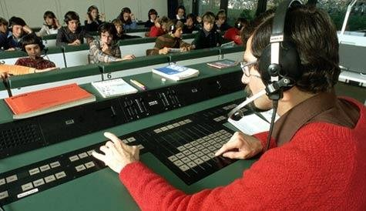
technologische Entwicklung

Slide 4
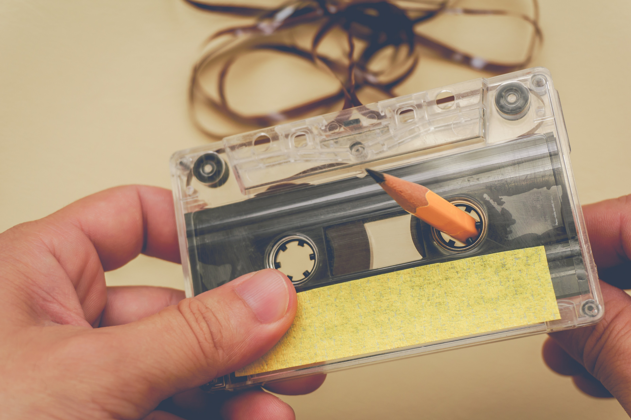
technologische Entwicklung

Slide 5
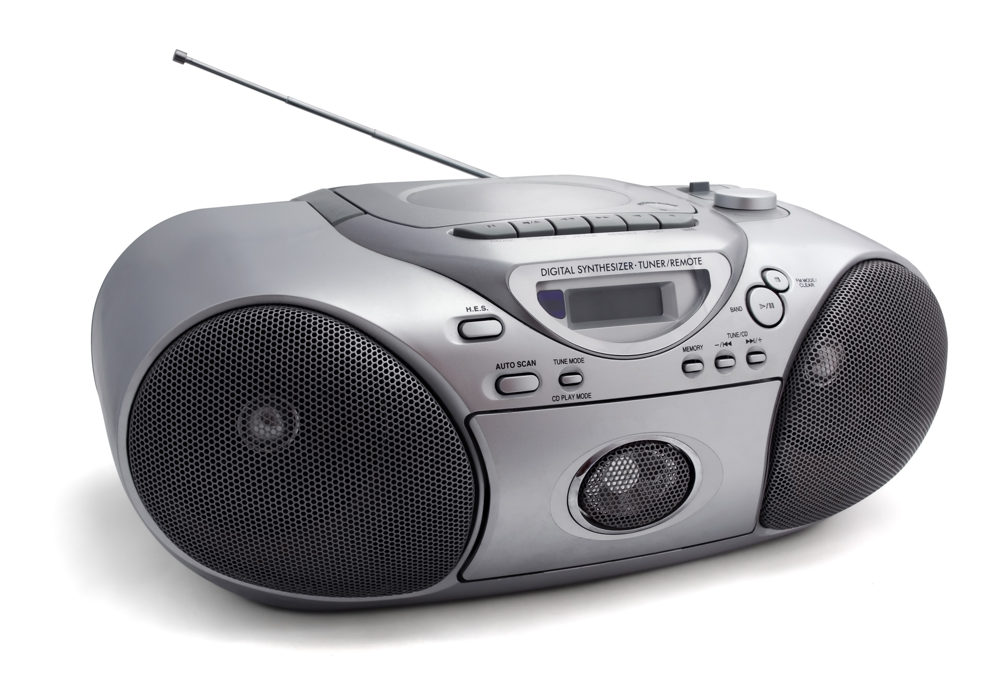
technologische Entwicklung

Slide 6
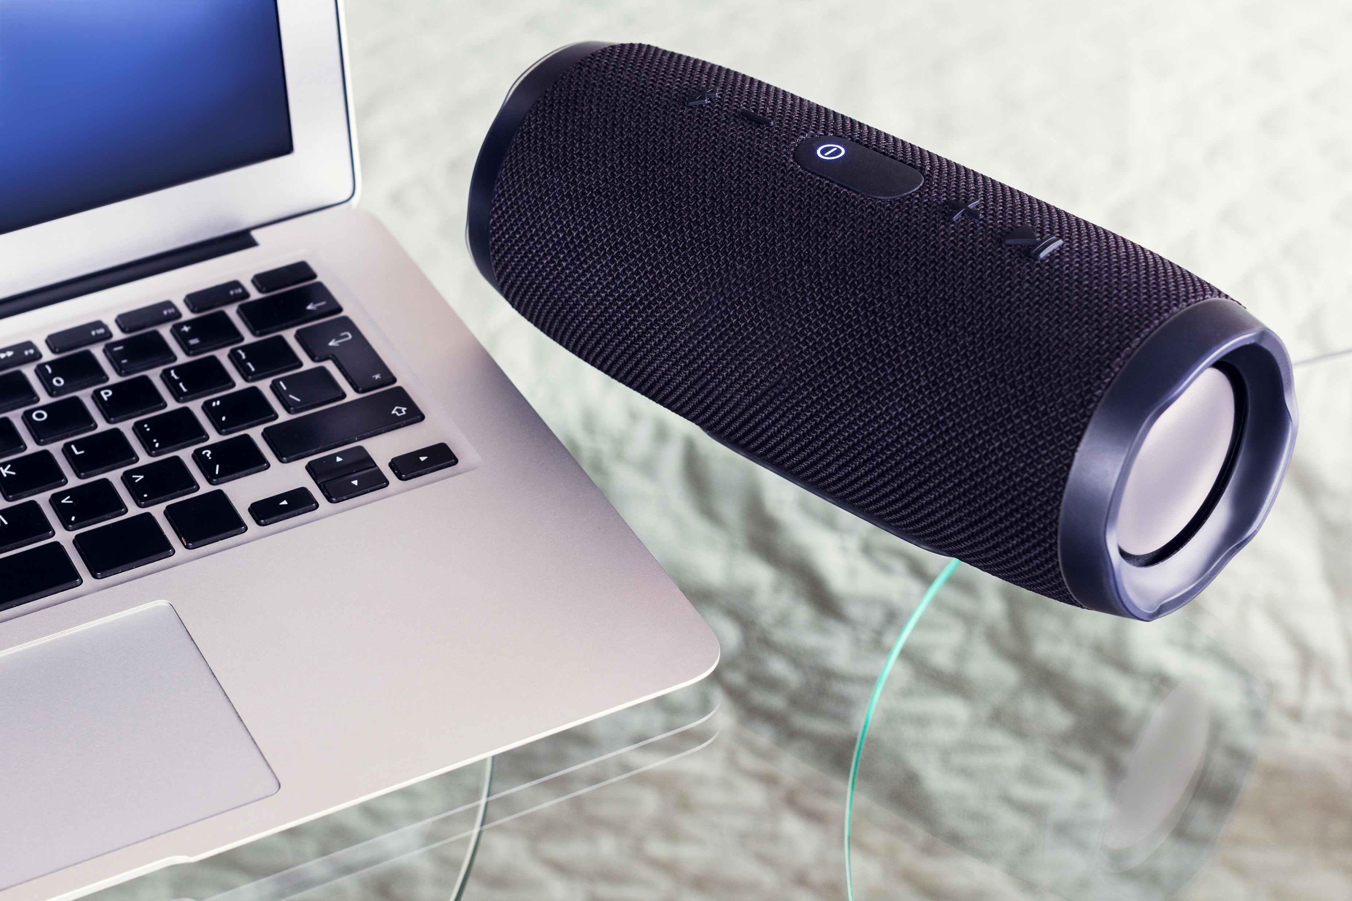
technologische Entwicklung

Slide 7
technologische Entwicklung

Slide 8
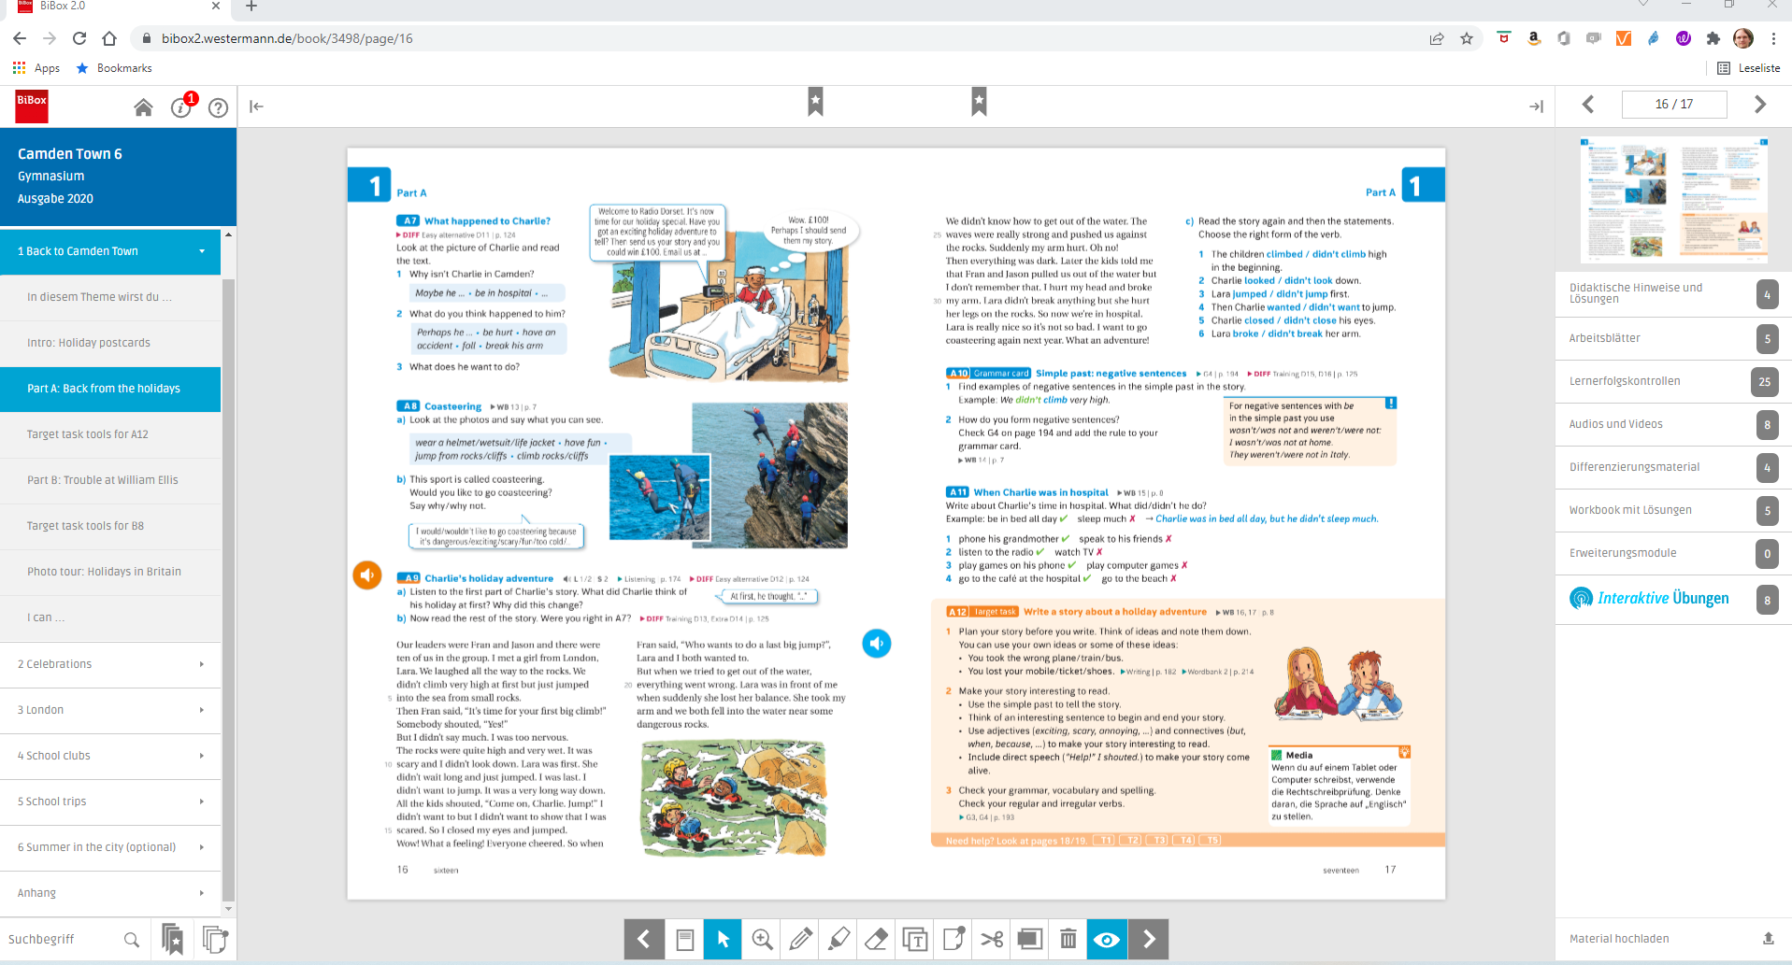

Slide 10
“Maybe from as early as when you’re five or six, there’s been a whisper going at the back of your head, saying: “One day, maybe not so long from now, you’ll get to know how it feels.” So you’re waiting, even if you don’t quite know it, waiting for the moment when you realise that you really are different to them; that there are people out there, like Madame, who don’t hate you or wish you any harm, but who nevertheless shudder at the very thought of you – of how you were brought into this world and why – and who dread the idea of your hand brushing against theirs. The first time you glimpse yourself through the eyes of a person like that, it’s a cold moment. It’s like walking past a mirror you’ve walked past every day of your life, and suddenly it shows you something else, something troubling and strange.”

Slide 11
ChatGPT

Slide 12
Analyse the atmosphere and use of language in this extract.

Slide 13
In this extract, the author effectively creates a somber and introspective atmosphere through the use of figurative language and a first-person narrative. The use of phrases such as "a whisper going at the back of your head" and "the first time you glimpse yourself through the eyes of a person like that" allows the reader to empathize with the narrator and feel the sense of alienation and self-discovery the character experiences.

Slide 14
In this extract, the author effectively creates a somber and introspective atmosphere through the use of figurative language and a first-person narrative. The use of phrases such as "a whisper going at the back of your head" and "the first time you glimpse yourself through the eyes of a person like that" allows the reader to empathize with the narrator and feel the sense of alienation and self-discovery the character experiences.
The language used is both poetic and evocative, with phrases like "cold moment" and "something troubling and strange" painting a vivid picture of the protagonist's emotional state. The metaphor of the mirror serves to highlight the self-awareness and self-questioning that the character undergoes, making the reader question their own perceptions and prejudices.

Slide 15
In this extract, the author effectively creates a somber and introspective atmosphere through the use of figurative language and a first-person narrative. The use of phrases such as "a whisper going at the back of your head" and "the first time you glimpse yourself through the eyes of a person like that" allows the reader to empathize with the narrator and feel the sense of alienation and self-discovery the character experiences.
The language used is both poetic and evocative, with phrases like "cold moment" and "something troubling and strange" painting a vivid picture of the protagonist's emotional state. The metaphor of the mirror serves to highlight the self-awareness and self-questioning that the character undergoes, making the reader question their own perceptions and prejudices.
The author's choice of words, such as "shudder," "dread," and "hate," creates a sense of unease and tension, building up the atmosphere and further emphasizing the theme of difference and otherness. Overall, the author effectively uses language and atmosphere to explore complex emotions and provoke thought in the reader.

Slide 16
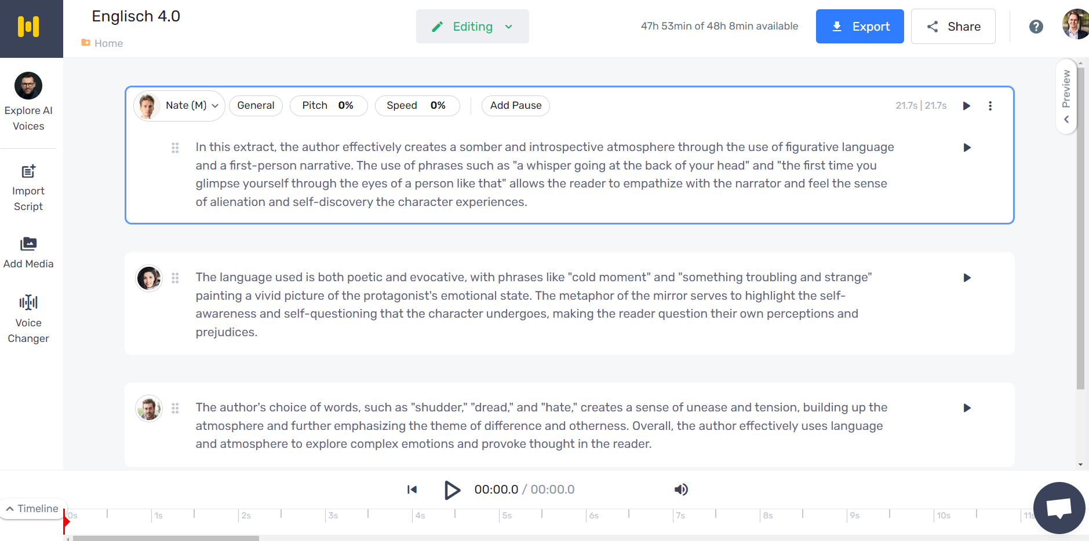

Slide 17
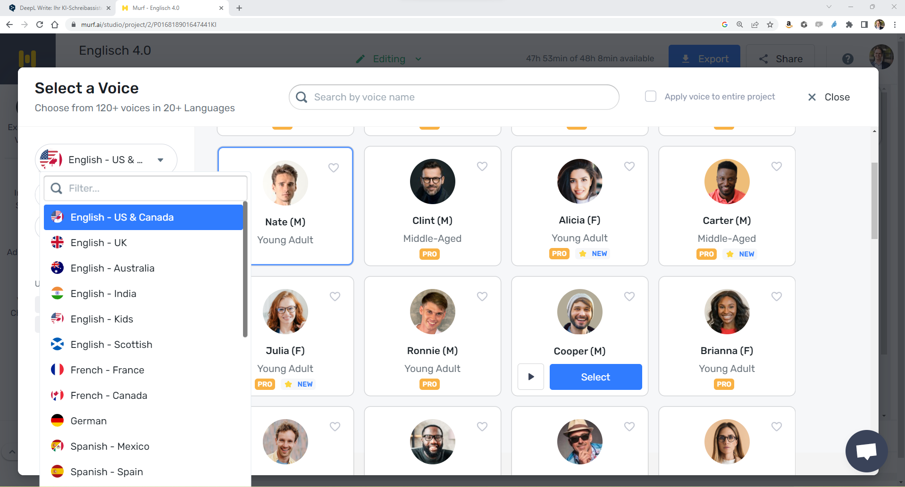

Slide 18
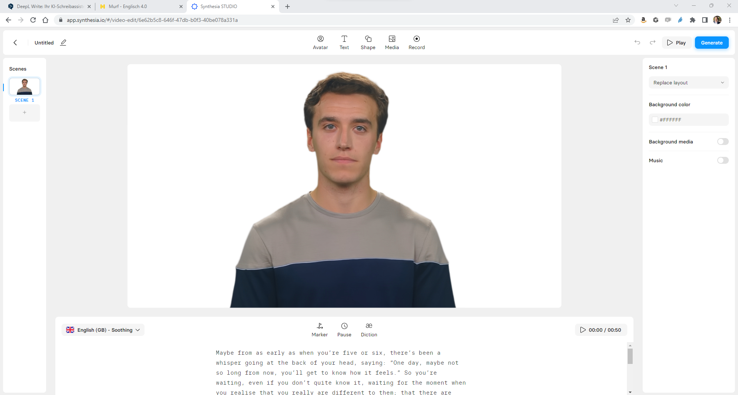

Slide 19
Let‘s listen

Slide 20
Let‘s listen
Audiodateien in Schulbüchern
Podcasts

Slide 21
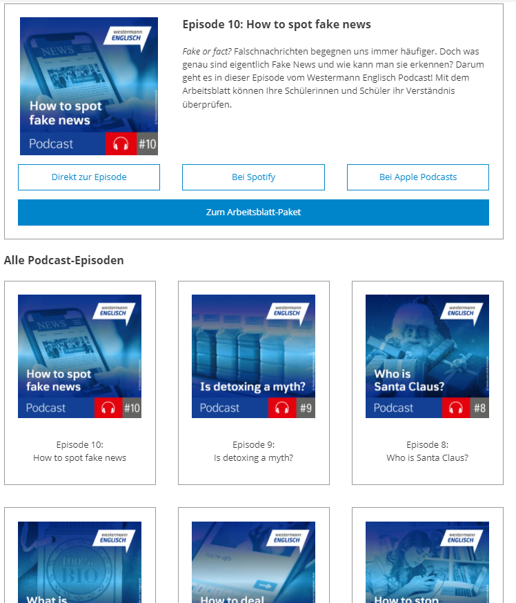
Let‘s listen – Podcasts – Westermann Englisch

Slide 22
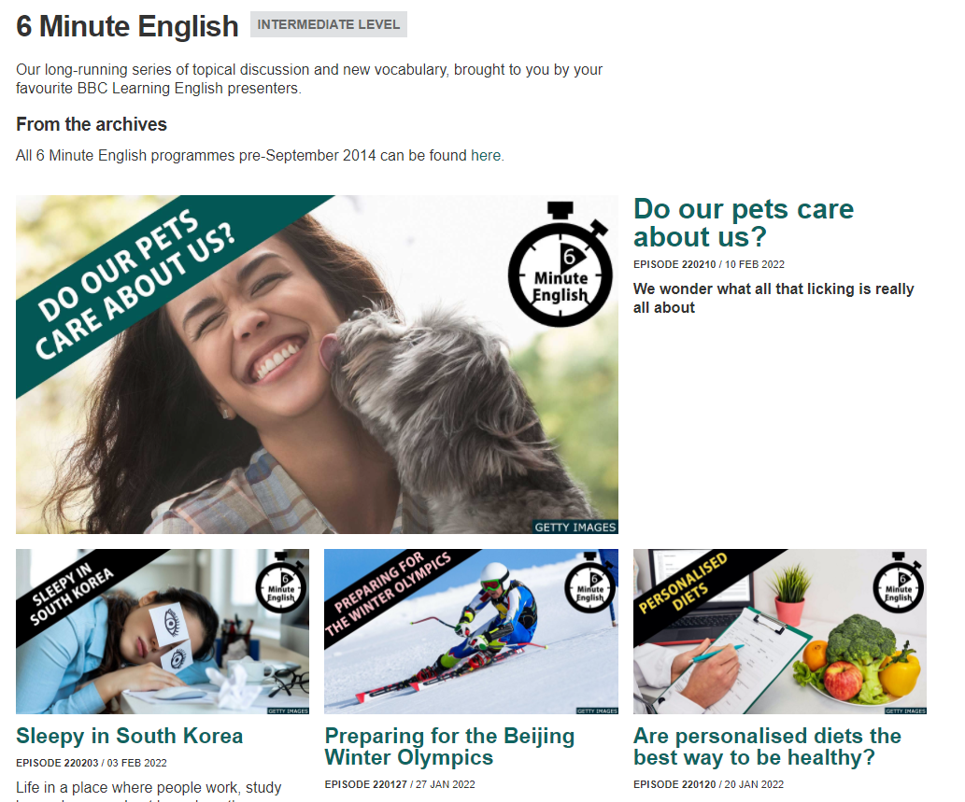
Let‘s listen – Podcasts – BBC 6 Minute English

Slide 23
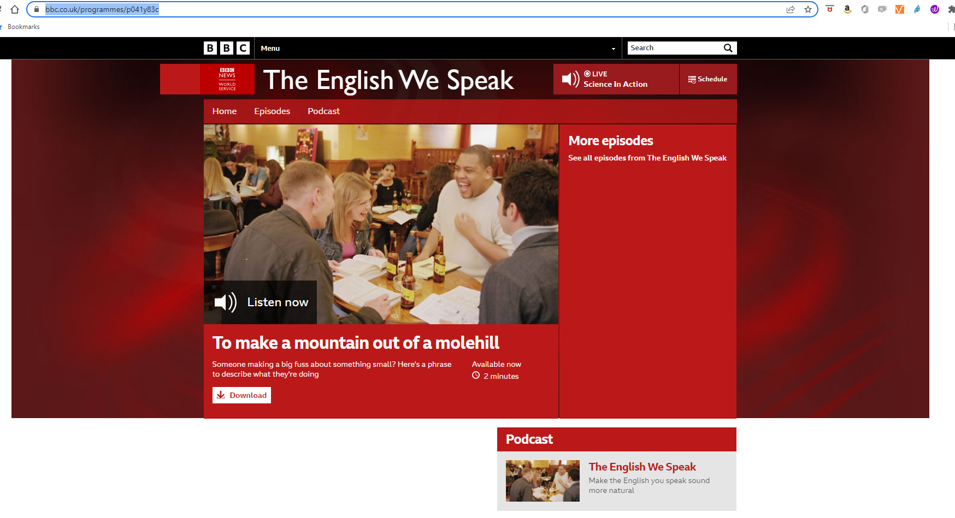
Let‘s listen – Podcasts – BBC The English we speak
https://www.bbc.co.uk/sounds/play/p041y83c

Slide 24
Methoden für den Unterricht
Listening comprehension
Predictions
Summarize
Conversation starter
Write a letter to the podcaster
Fill in the blank
Bingo

Slide 25
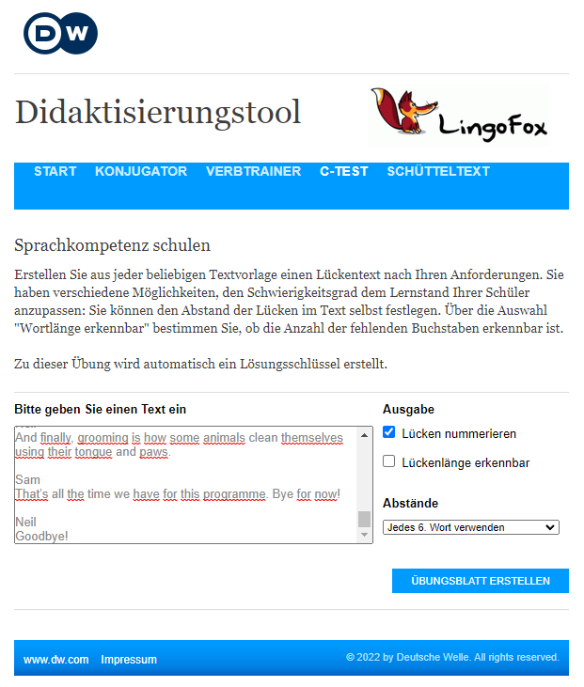
Cloze Test / C-TEst

Slide 26
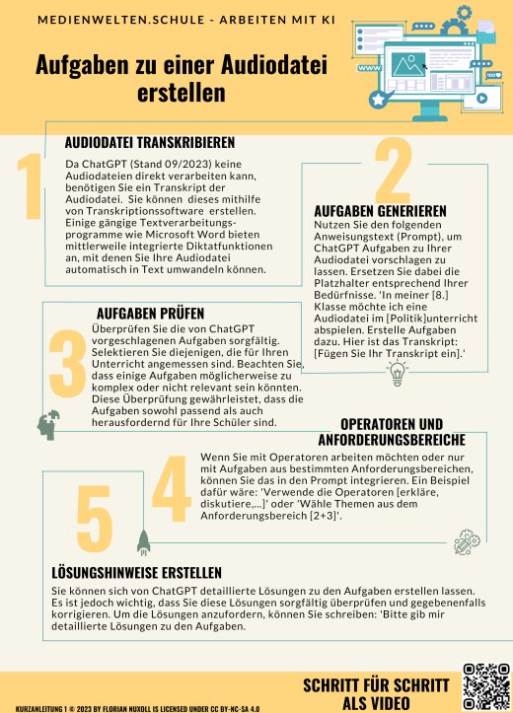

Slide 27
Die Schüler:innen sollen einen engl. Podcast finden, der sie interessiert.

Slide 28
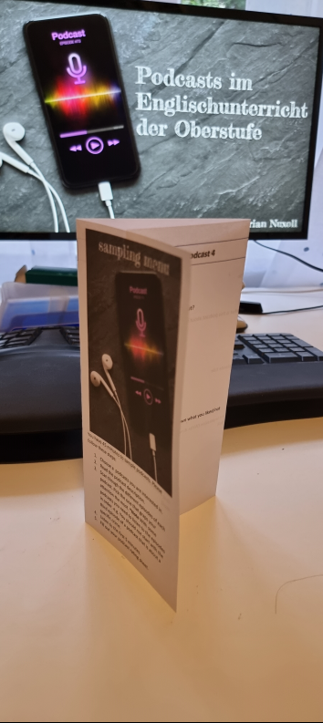
Let‘s listen – Podcasts – Find your favourite Podcast

Slide 29
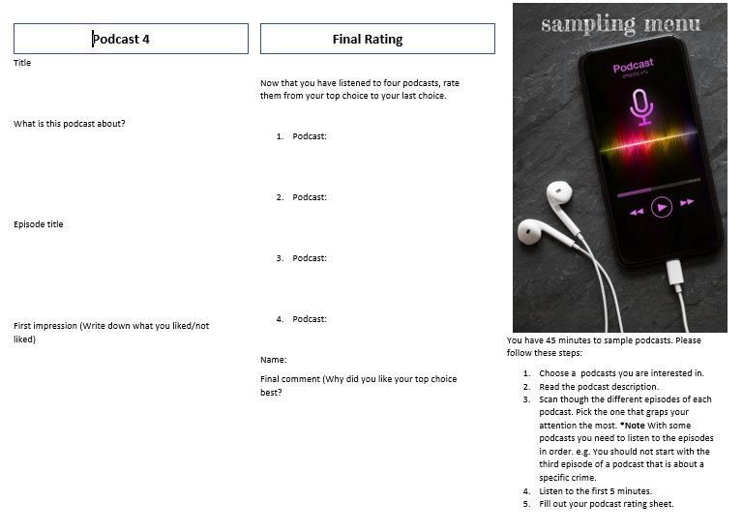
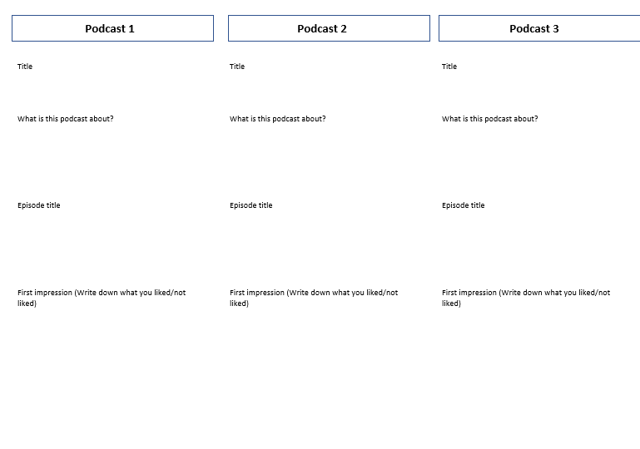
Podcast Tasting

Slide 30
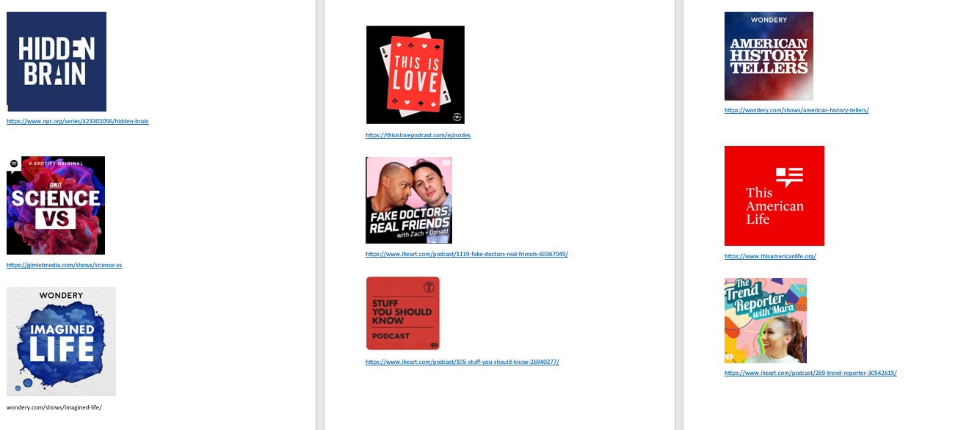

Slide 31
Let‘s record

Slide 32
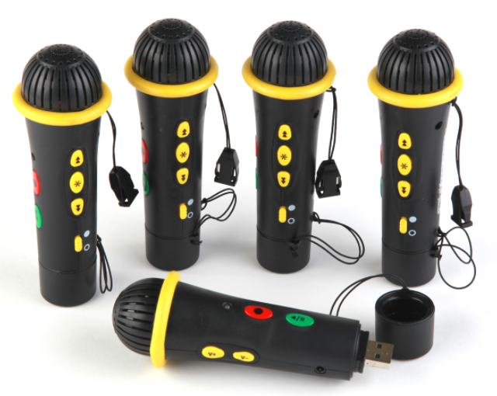
Let‘s record – What you need
easi speak
Smartphone/Tablet

Slide 33
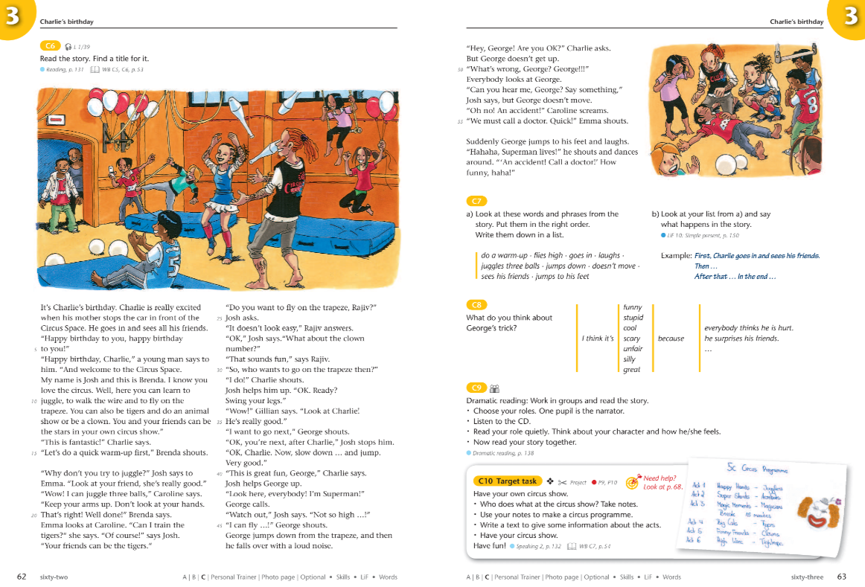
Let‘s record - Unterstufe

Slide 34
Let‘s record – Mittel- und Oberstufe

Slide 35
Schüler:innen lesen zu Hause Texte vor und nehmen es auf.

Slide 36
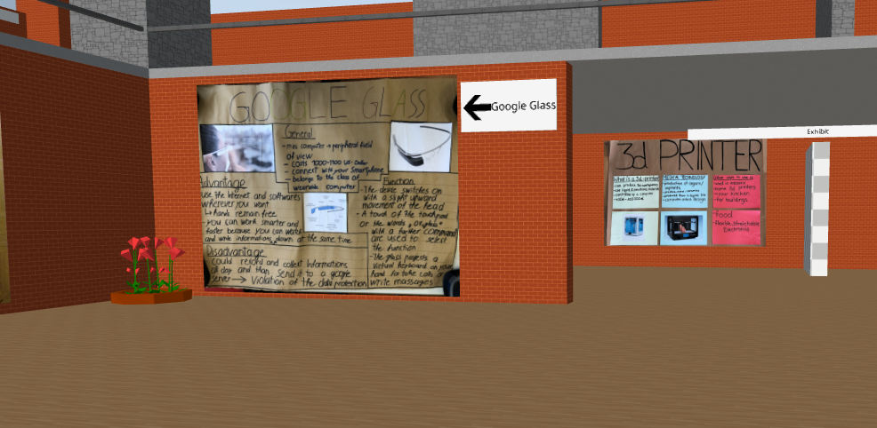
Posterpräsentation

Slide 37
Let‘s record – Gruppen- und PArtnerarbeit

Slide 38
Let‘s record – Gruppen- und PArtnerarbeit

Slide 39
Gruppen- und Partnerarbeit manchmal aufnehmen lassen.

Slide 40
AudioFeedback geben

Slide 41
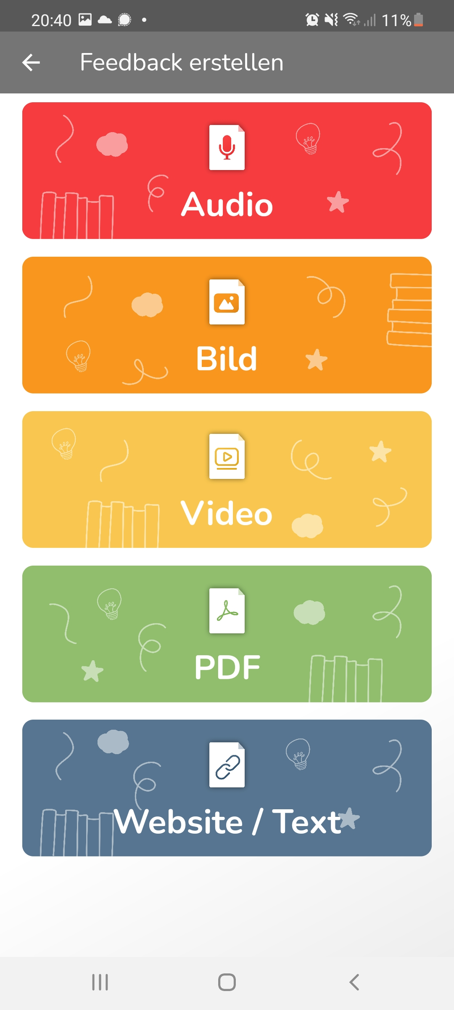
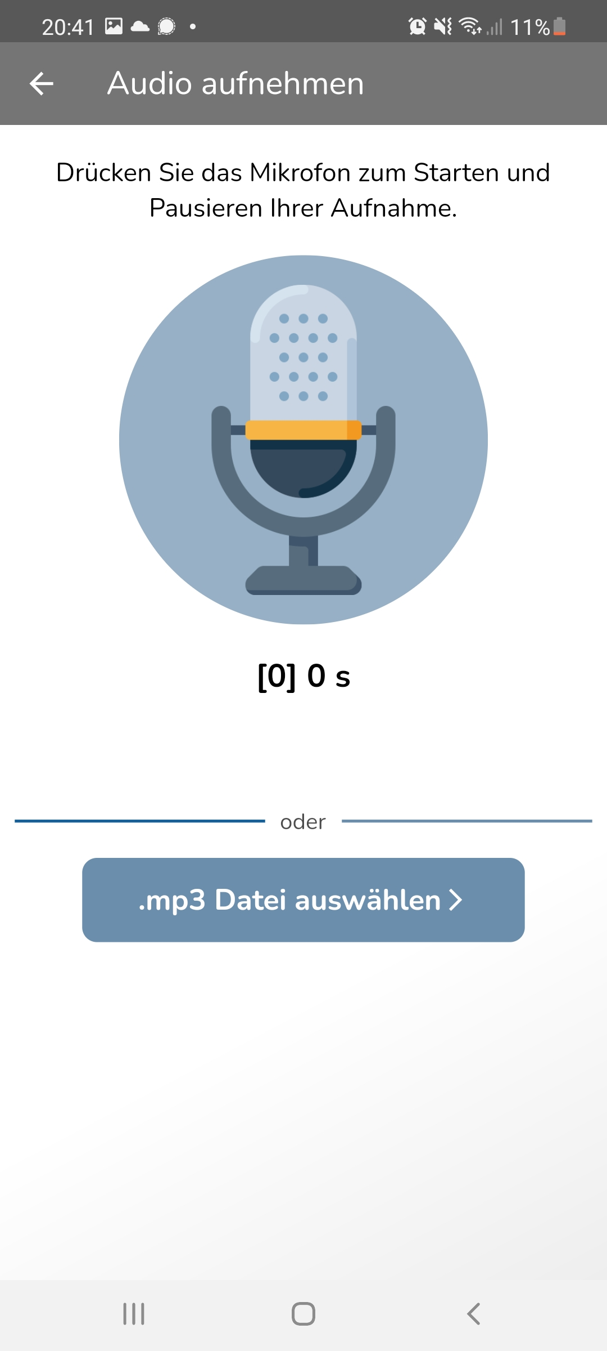
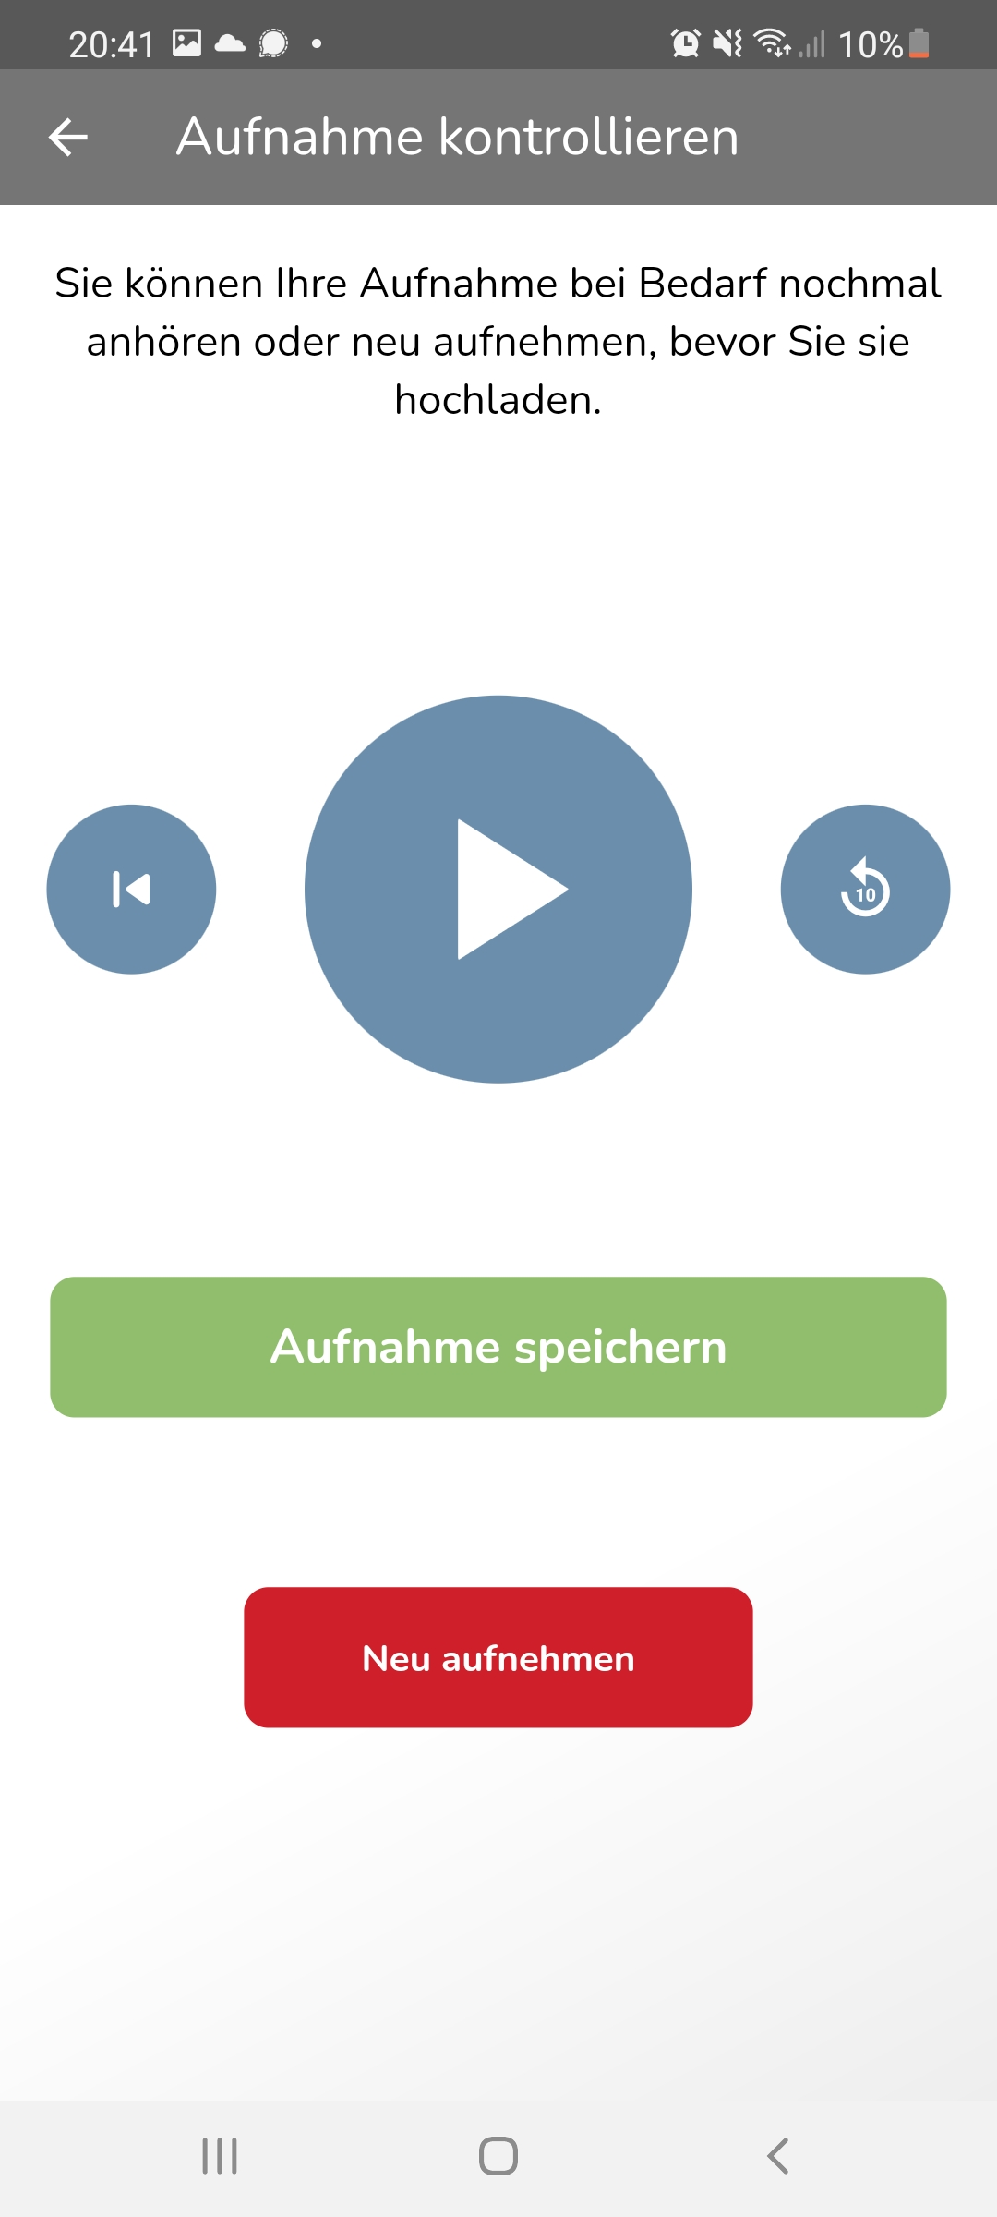
AudioFeedback geben

Slide 42
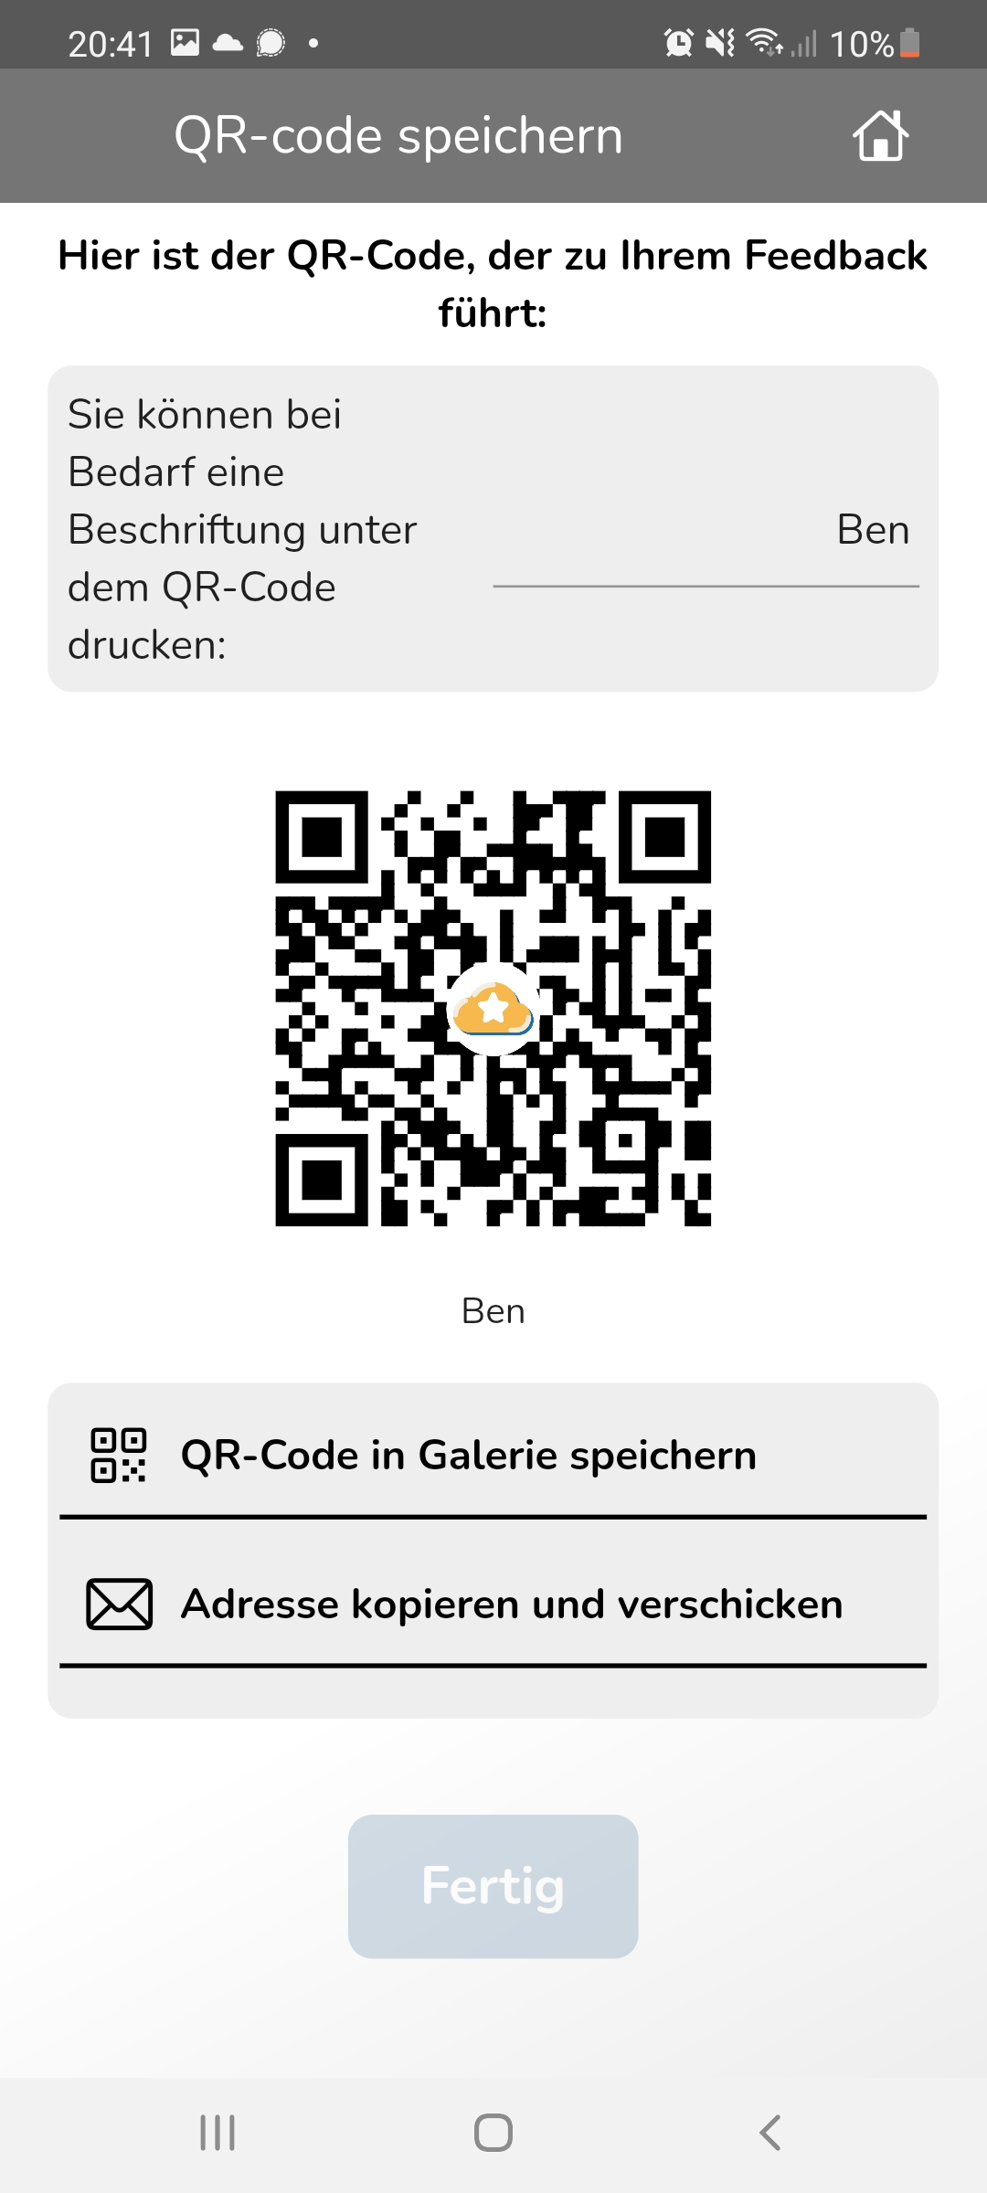
AudioFeedback geben

Slide 43
Geben Sie Audiofeedback!

Slide 44
Geben Sie Audiofeedback!
Gruppen- und Partnerarbeit manchmal aufnehmen lassen.
Schüler:innen lesen zu Hause Texte vor und nehmen es auf.
Die Schüler:innen sollen einen engl. Podcast finden, der sie interessiert.

Slide 45
Der Audioaustausch

Slide 46
Virtueller Austausch
Audio 1
Introduce yourself (30 sec)
our school (30-60sec)

Slide 47
Virtueller Austausch
Audio 1

Slide 48
Kontaktdaten
florian.nuxoll@gmx.net
medienwelten.schule
https://doppelstunde.letscast.fm/

