Slide 1
Englisch in der Oberstufe 4.0
Florian Nuxoll

Slide 3



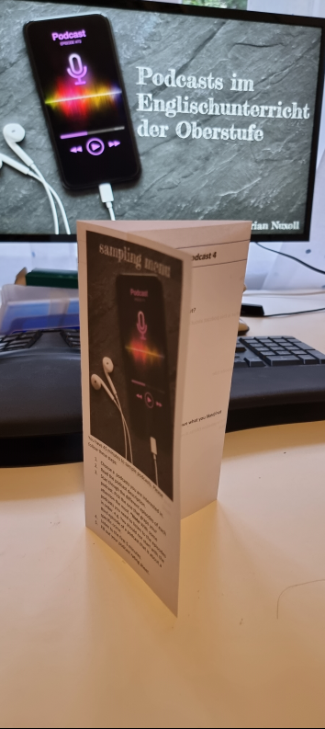


Slide 4
Was ist anders in Ihrem Oberstufenunterricht heute?
Wie groß ist der Unterschied?
Skala 0 bis 10
0=keine Veränderung
10= alles anders

Slide 6
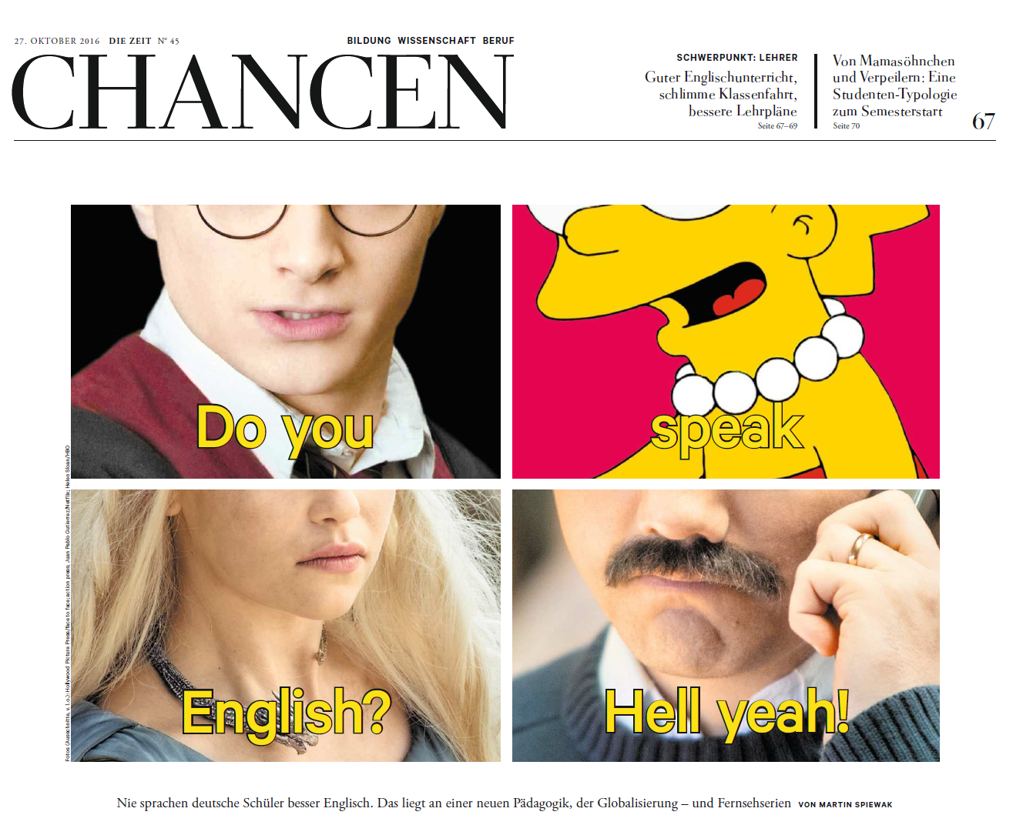
Zeit Nr. 45 2016

Slide 7

ChatGPT

Slide 8


Slide 9
“Maybe from as early as when you’re five or six, there’s been a whisper going at the back of your head, saying: “One day, maybe not so long from now, you’ll get to know how it feels.” So you’re waiting, even if you don’t quite know it, waiting for the moment when you realise that you really are different to them; that there are people out there, like Madame, who don’t hate you or wish you any harm, but who nevertheless shudder at the very thought of you – of how you were brought into this world and why – and who dread the idea of your hand brushing against theirs. The first time you glimpse yourself through the eyes of a person like that, it’s a cold moment. It’s like walking past a mirror you’ve walked past every day of your life, and suddenly it shows you something else, something troubling and strange.”

Slide 10
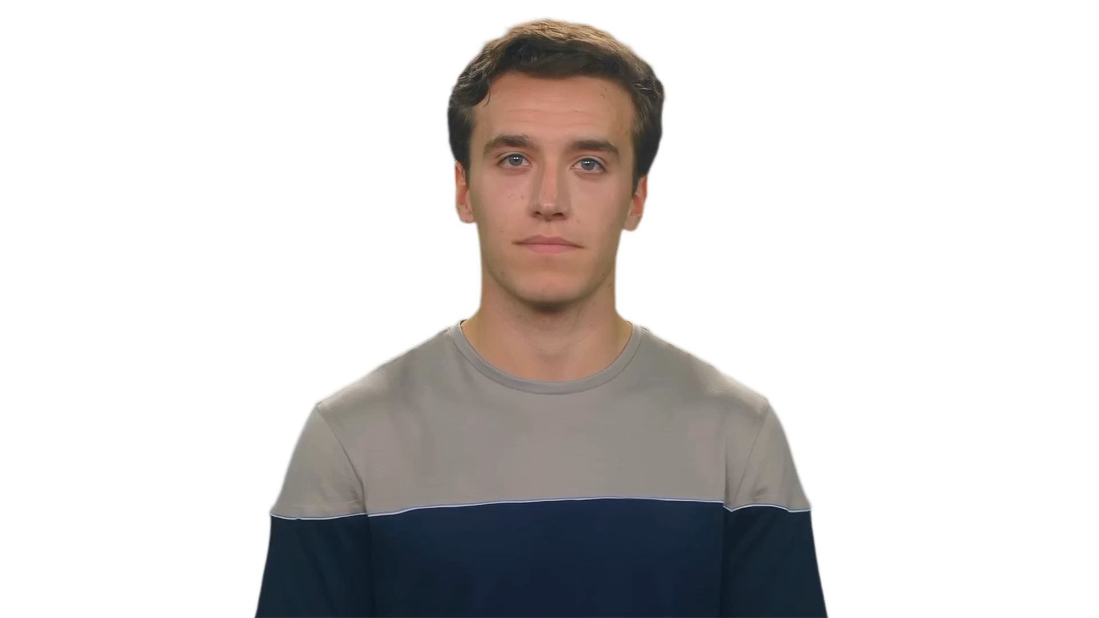

Slide 11
ChatGPT

Slide 12
Analyse the atmosphere and use of language in this extract.

Slide 13

In this extract, the author effectively creates a somber and introspective atmosphere through the use of figurative language and a first-person narrative. The use of phrases such as "a whisper going at the back of your head" and "the first time you glimpse yourself through the eyes of a person like that" allows the reader to empathize with the narrator and feel the sense of alienation and self-discovery the character experiences.
The language used is both poetic and evocative, with phrases like "cold moment" and "something troubling and strange" painting a vivid picture of the protagonist's emotional state. The metaphor of the mirror serves to highlight the self-awareness and self-questioning that the character undergoes, making the reader question their own perceptions and prejudices.
The author's choice of words, such as "shudder," "dread," and "hate," creates a sense of unease and tension, building up the atmosphere and further emphasizing the theme of difference and otherness. Overall, the author effectively uses language and atmosphere to explore complex emotions and provoke thought in the reader.

Slide 14
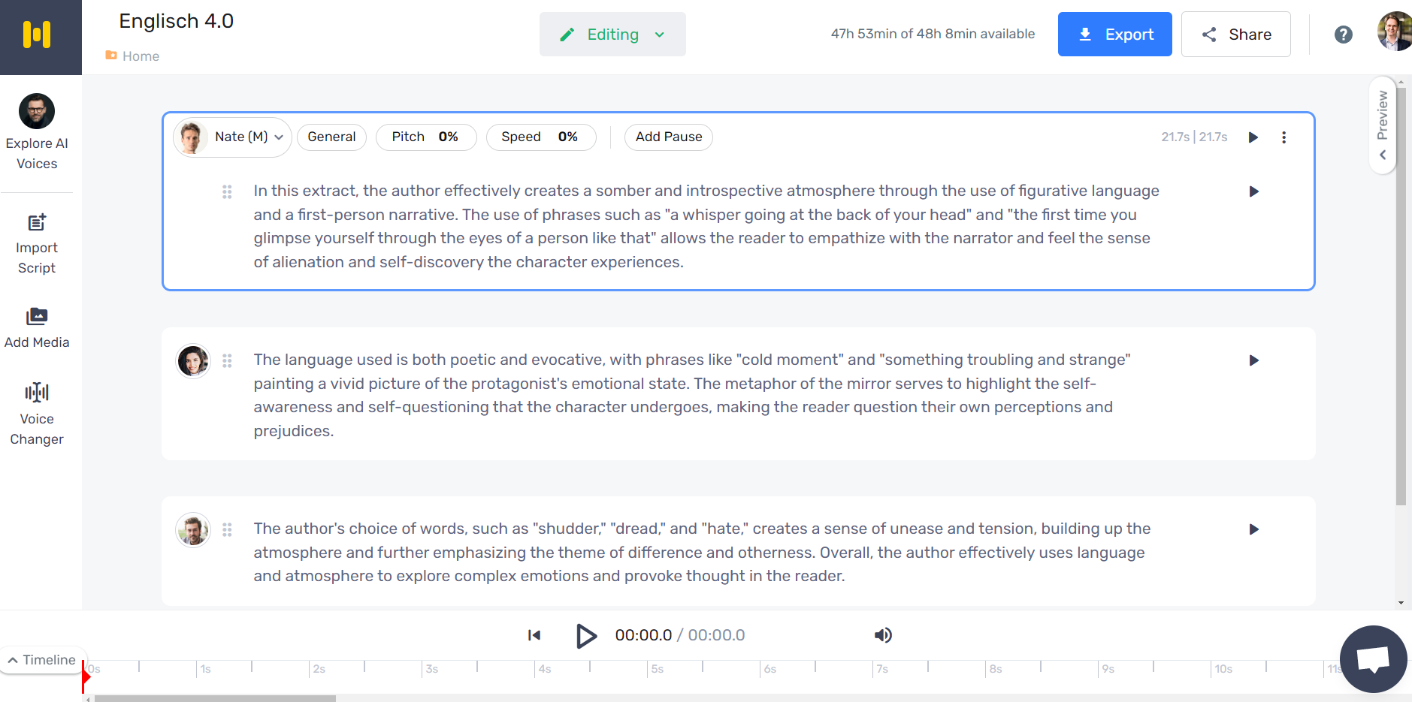

Slide 15
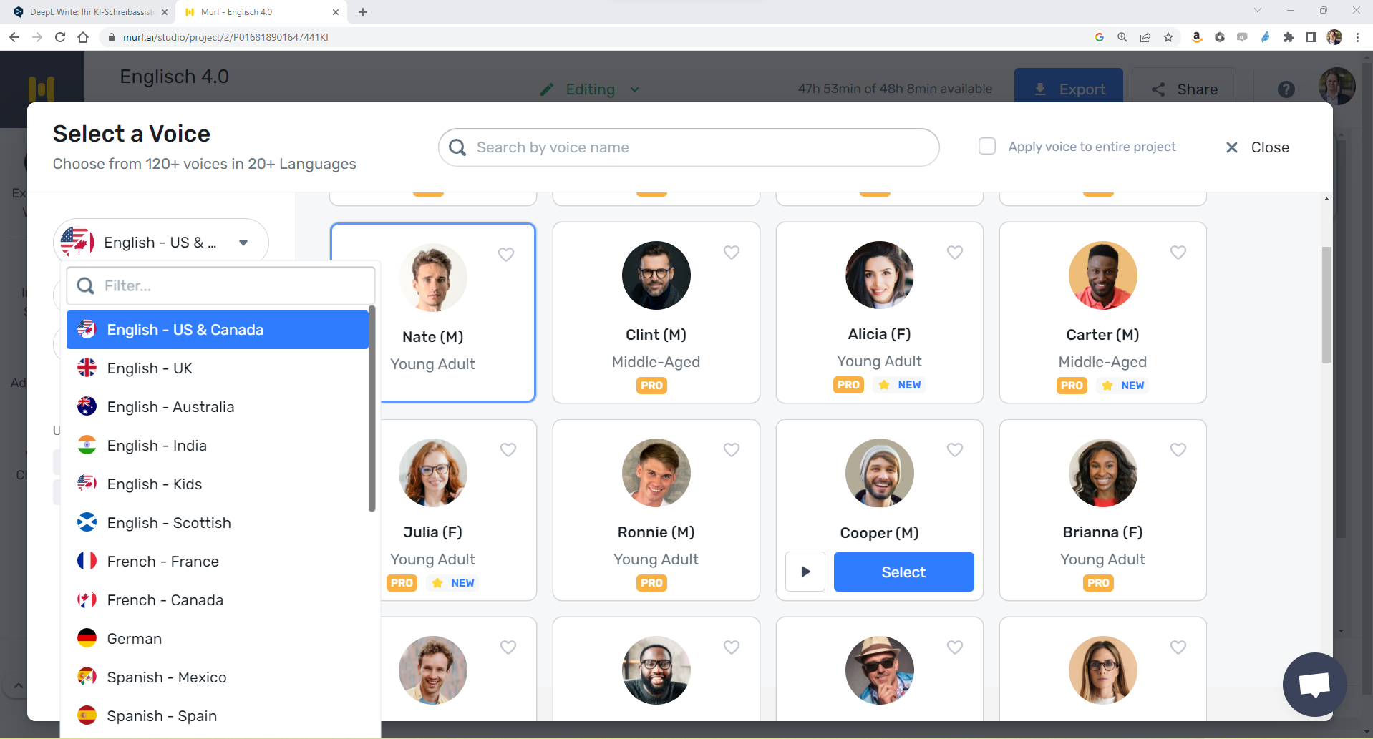

Slide 16
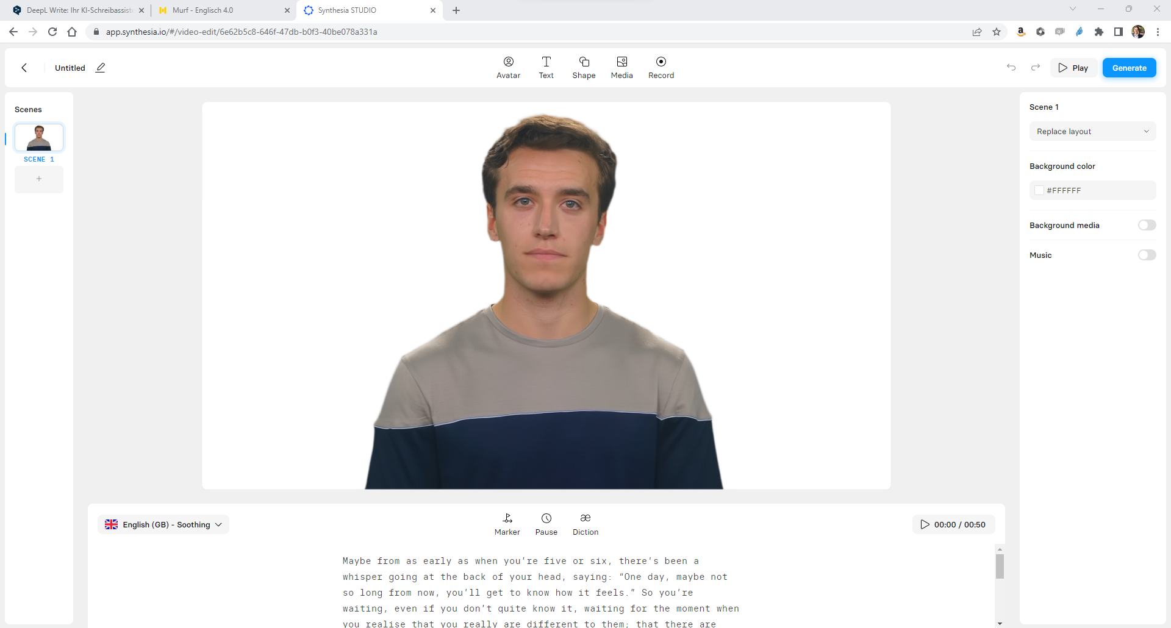

Slide 18
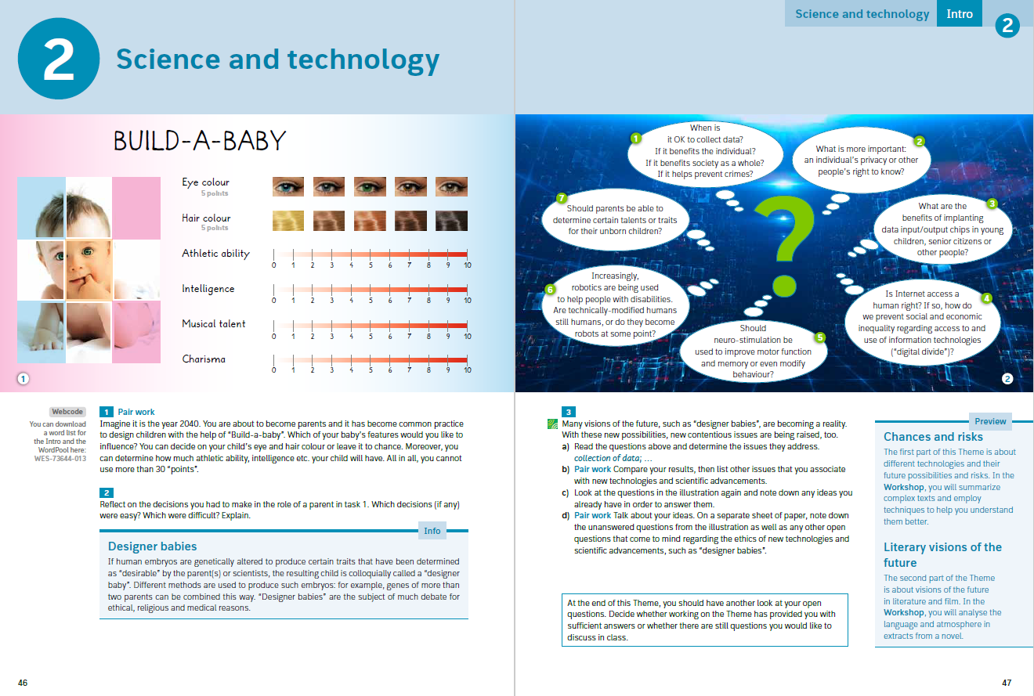

Slide 19
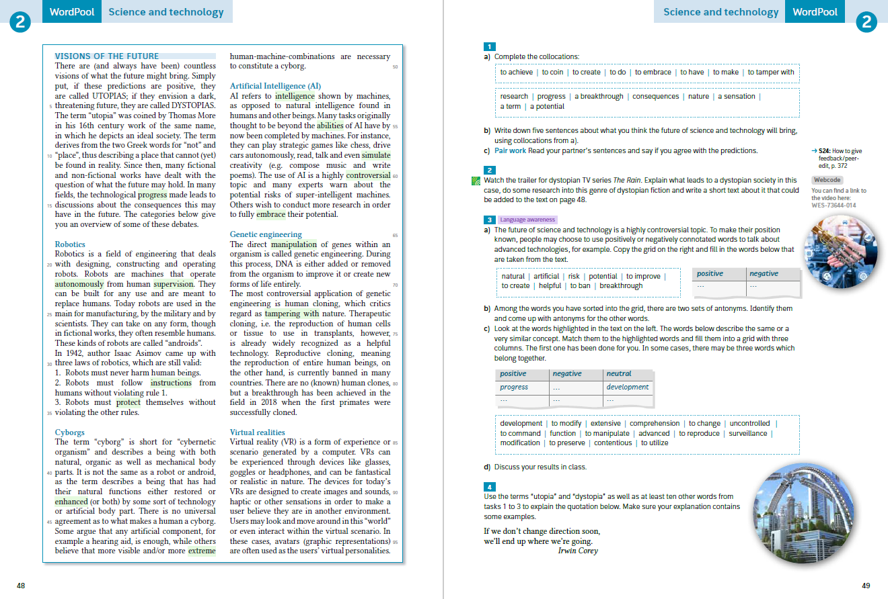

Slide 20
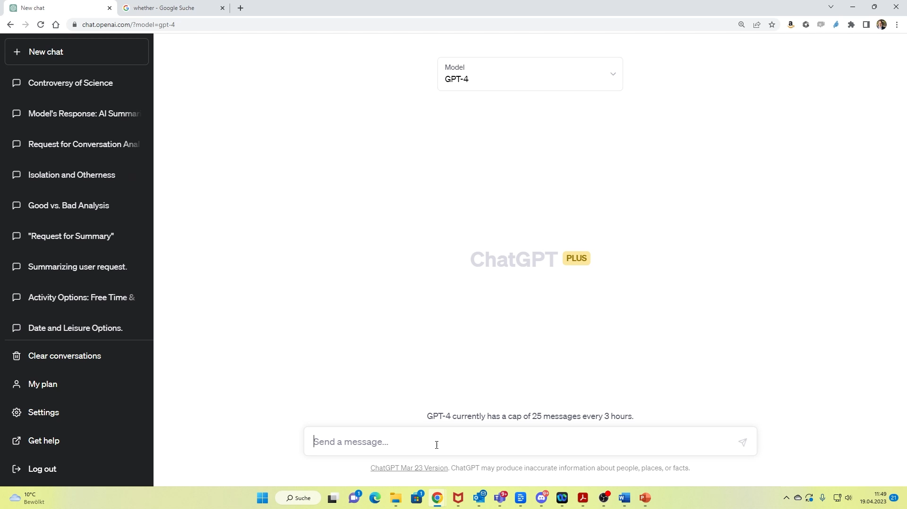

Slide 21
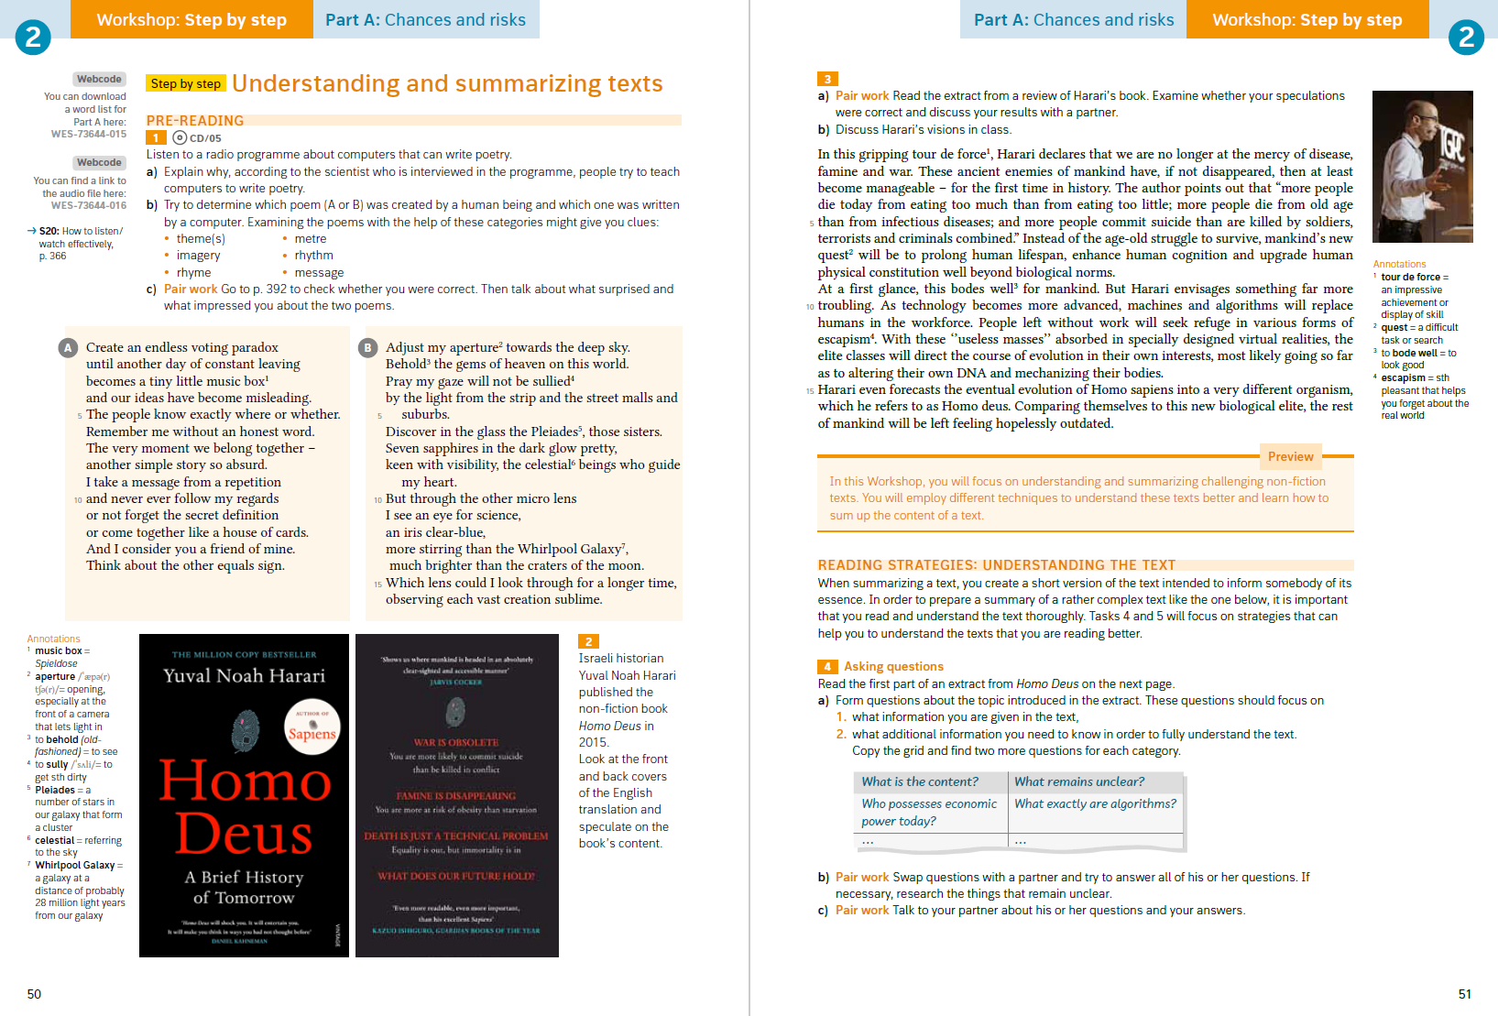

Slide 22
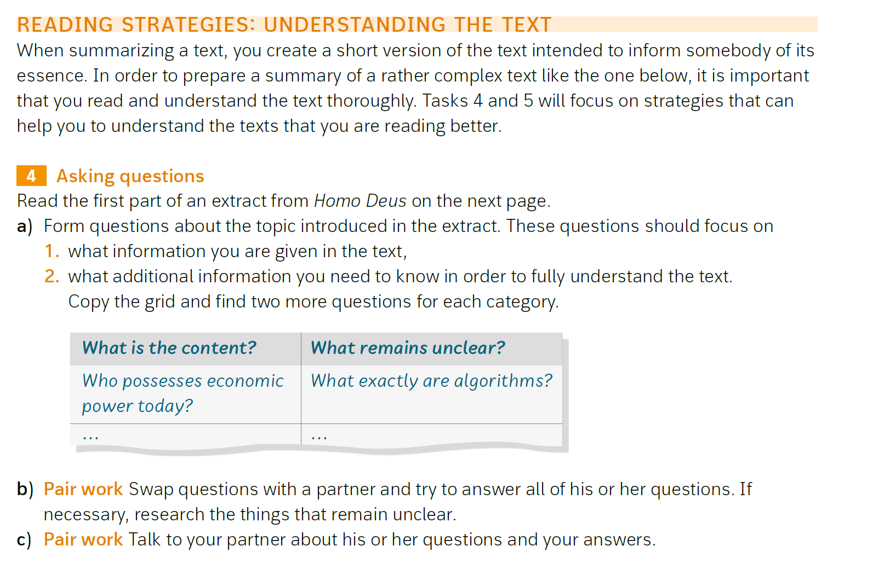

Slide 23
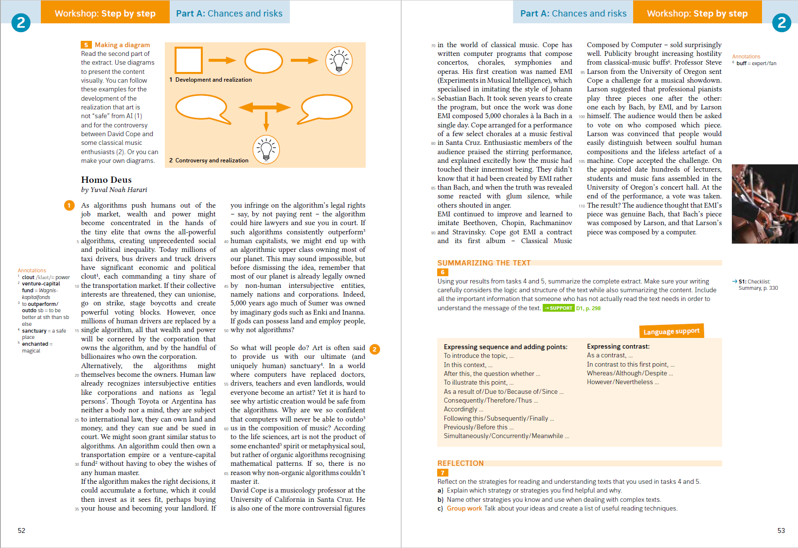

Slide 24
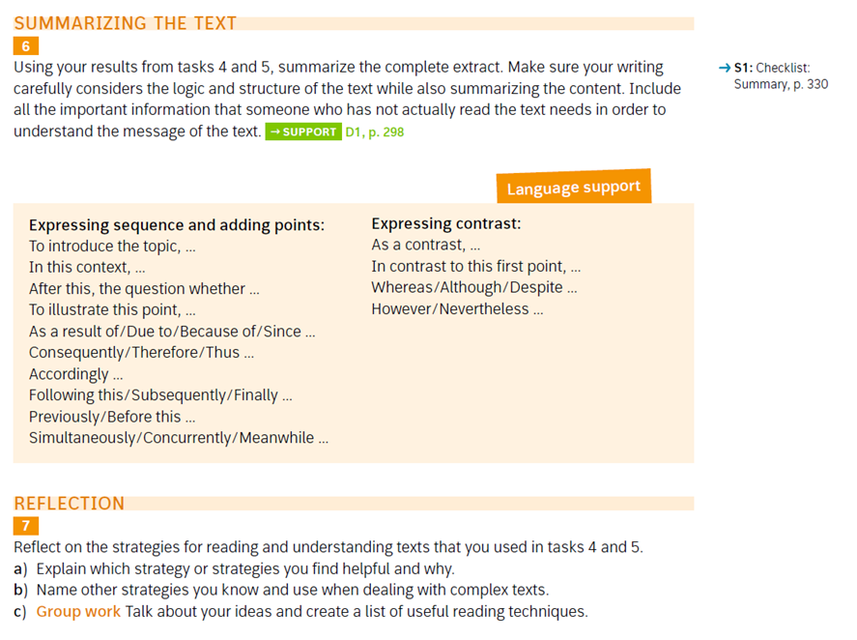

Slide 25
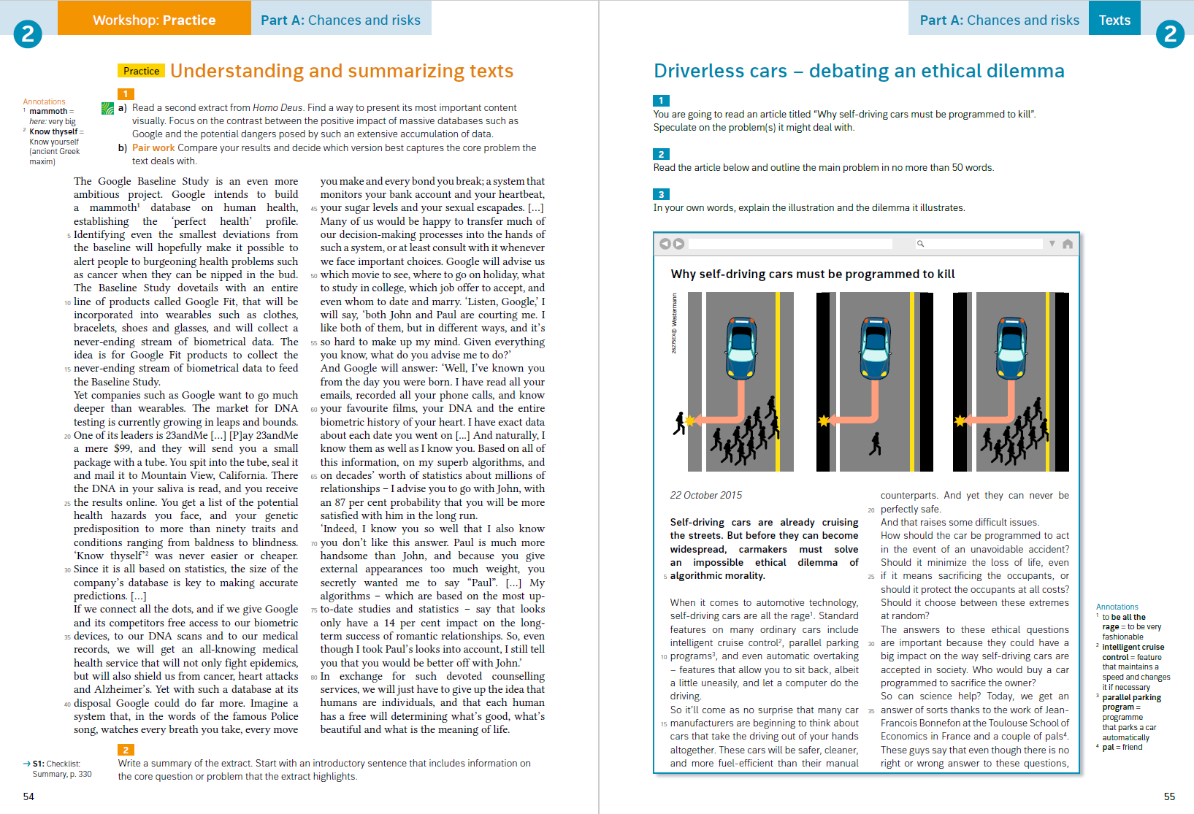

Slide 28
Guns are a very important aspekt of american society. I don't think that it is possible to have more strict gun laws. The NRA is against that and they organize protest. Eventough there are many sooting with guns in school there still are many peoples who don't want to give up their weapons.

Slide 29
Schüler:innen
KI kann beim Lernen helfen …
… oder Lernen verhindern.
Lernende müssen lernen wollen.
→ Mehr Metakognition

Slide 30
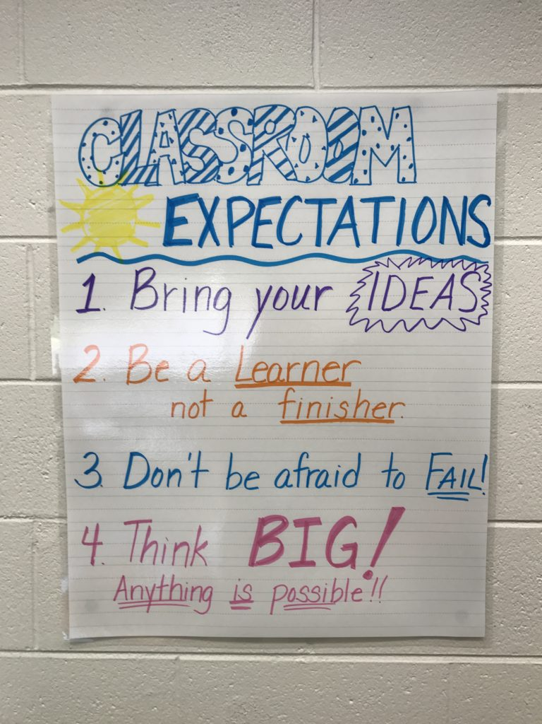

Slide 31
Was machen wir mit Hausaufgaben?

Slide 32

Weniger Textproduktion zu Hause.

Slide 33
Stattdessen:
- flipped classroom
- listening
- speaking

Slide 34
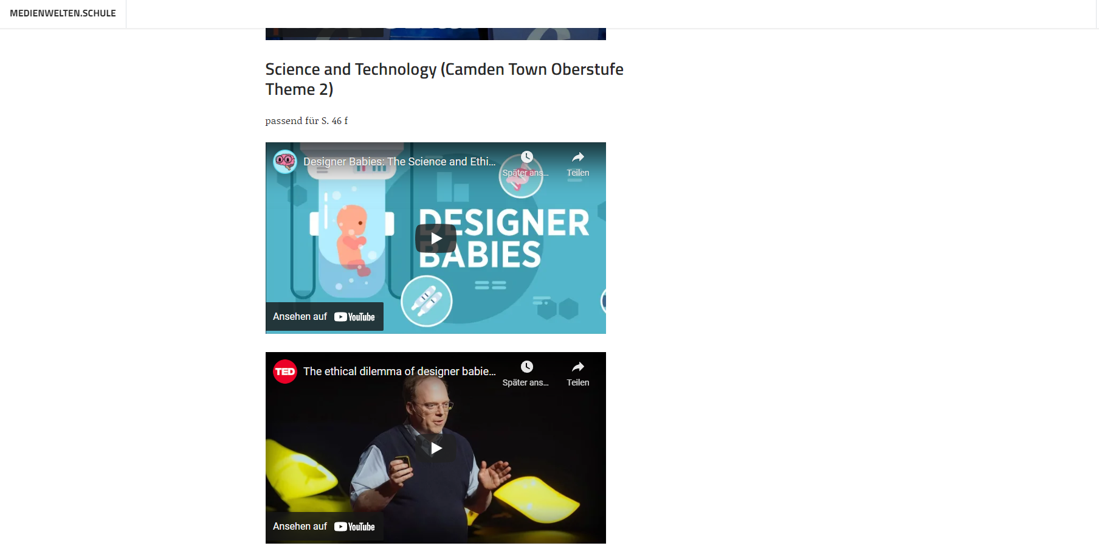

Slide 35
Let‘s listen – Podcasts – Find your favourite Podcast

Slide 36
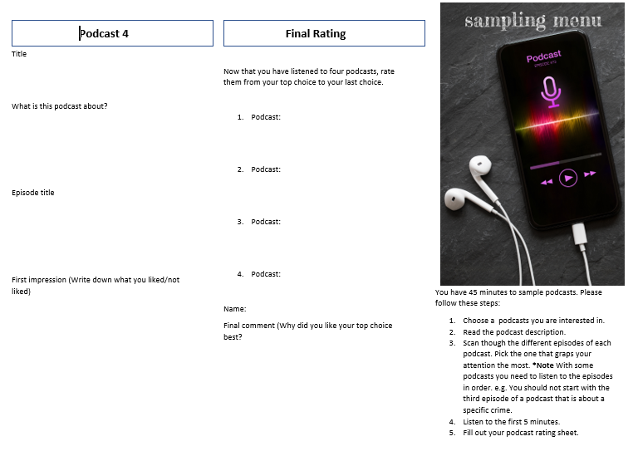
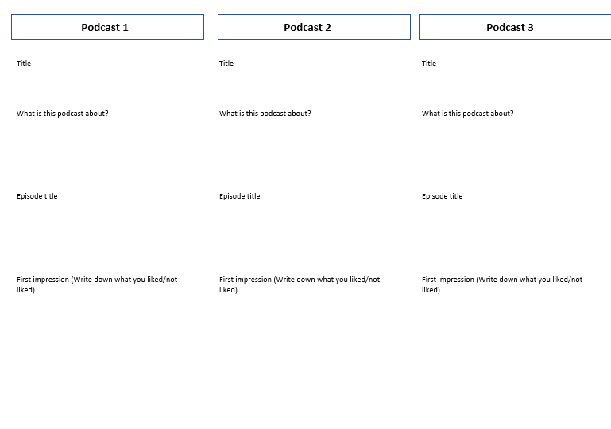
Podcast Tasting

Slide 37
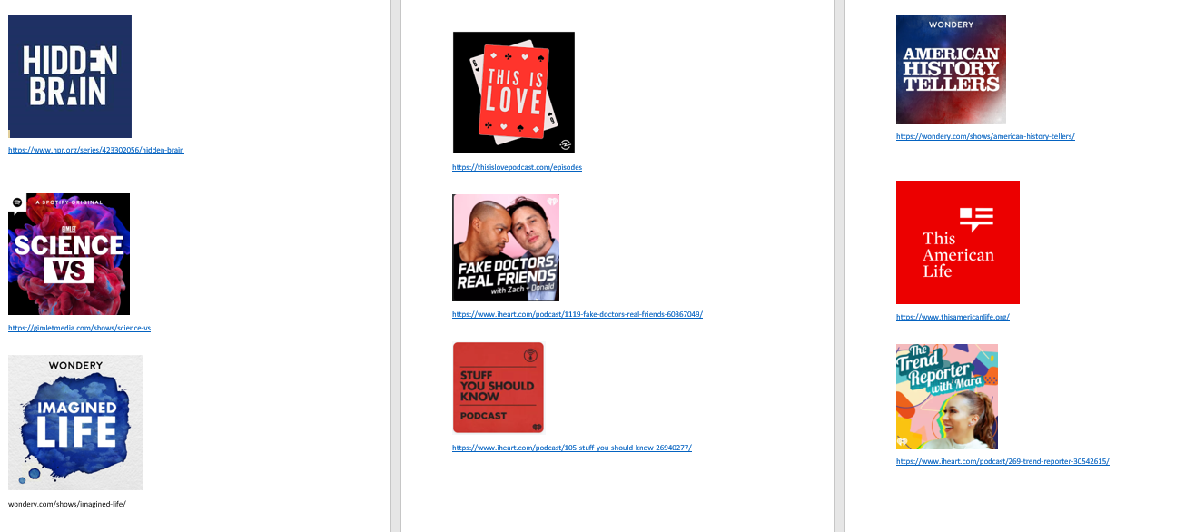

Slide 38

Let‘s record – Mittel- und Oberstufe

Slide 39
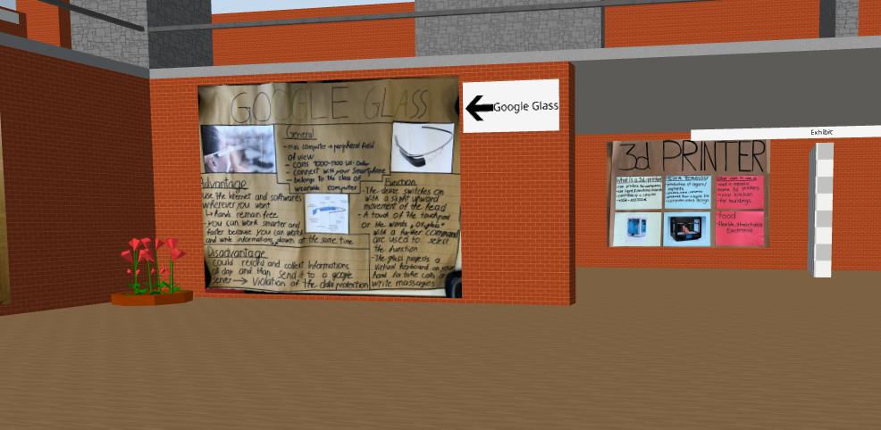
Posterpräsentation
cospaces.edu

Slide 40

Literatur
Notes:
Kommun

Slide 41
Literatur
Doppelstunde 1:
Vorbereitung (Szenenauswahl, Skript…)
Doppelstunde 2:
Filmen
Notes:
Kommun

Slide 42
digitaler Austausch

Slide 43
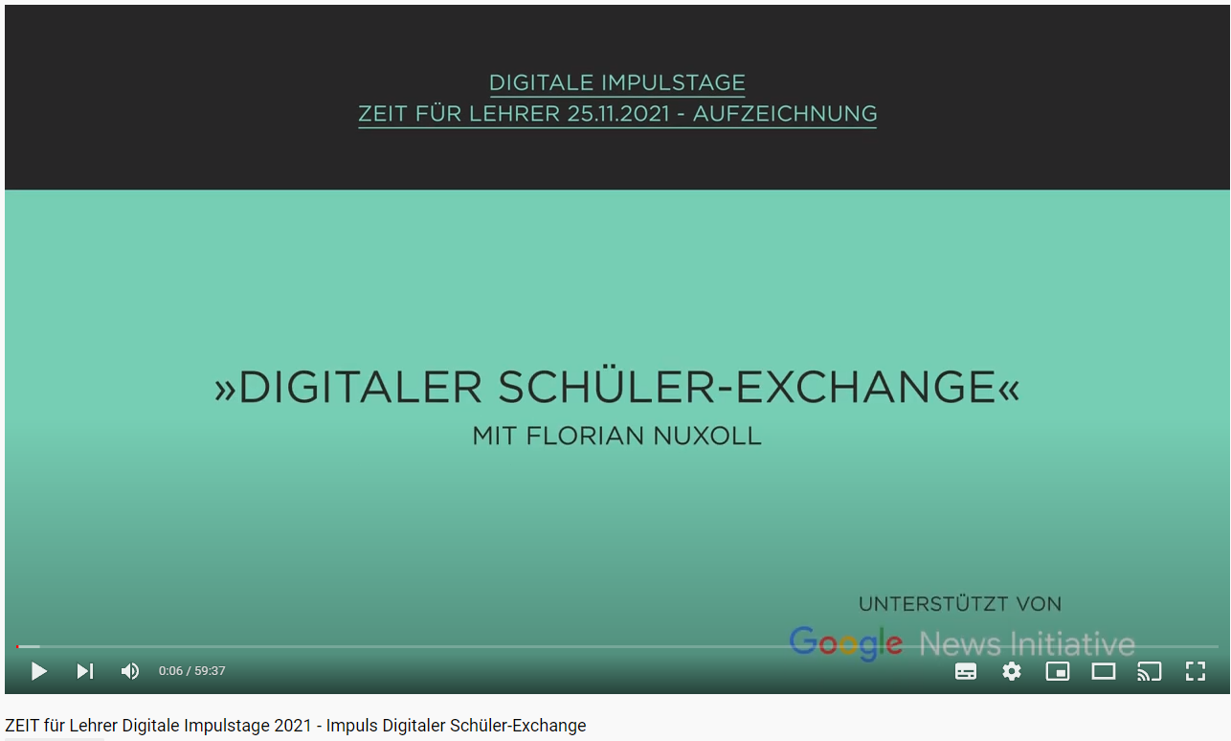
Let‘s record – digitaler Austausch
https://www.youtube.com/watch?v=IW4r36tvJiM

Slide 44

Einen Film, eine Episode oder einen YouTube Clip (mindestens 10 min lang)
-> Journal
What did I watch?
What was it about?
Which three words did I learn?

Slide 45



Slide 46
Intro
Wordpool
Workshop
Texts
Skill Training
Theme Task

Slide 47
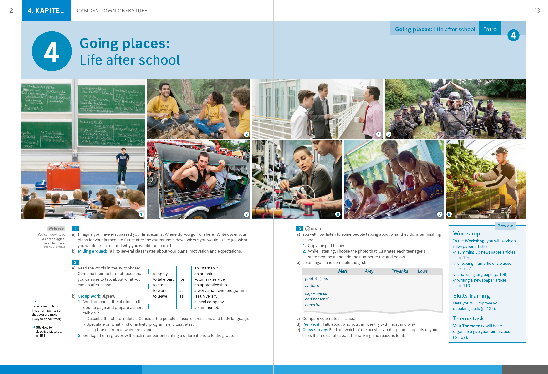

Slide 48
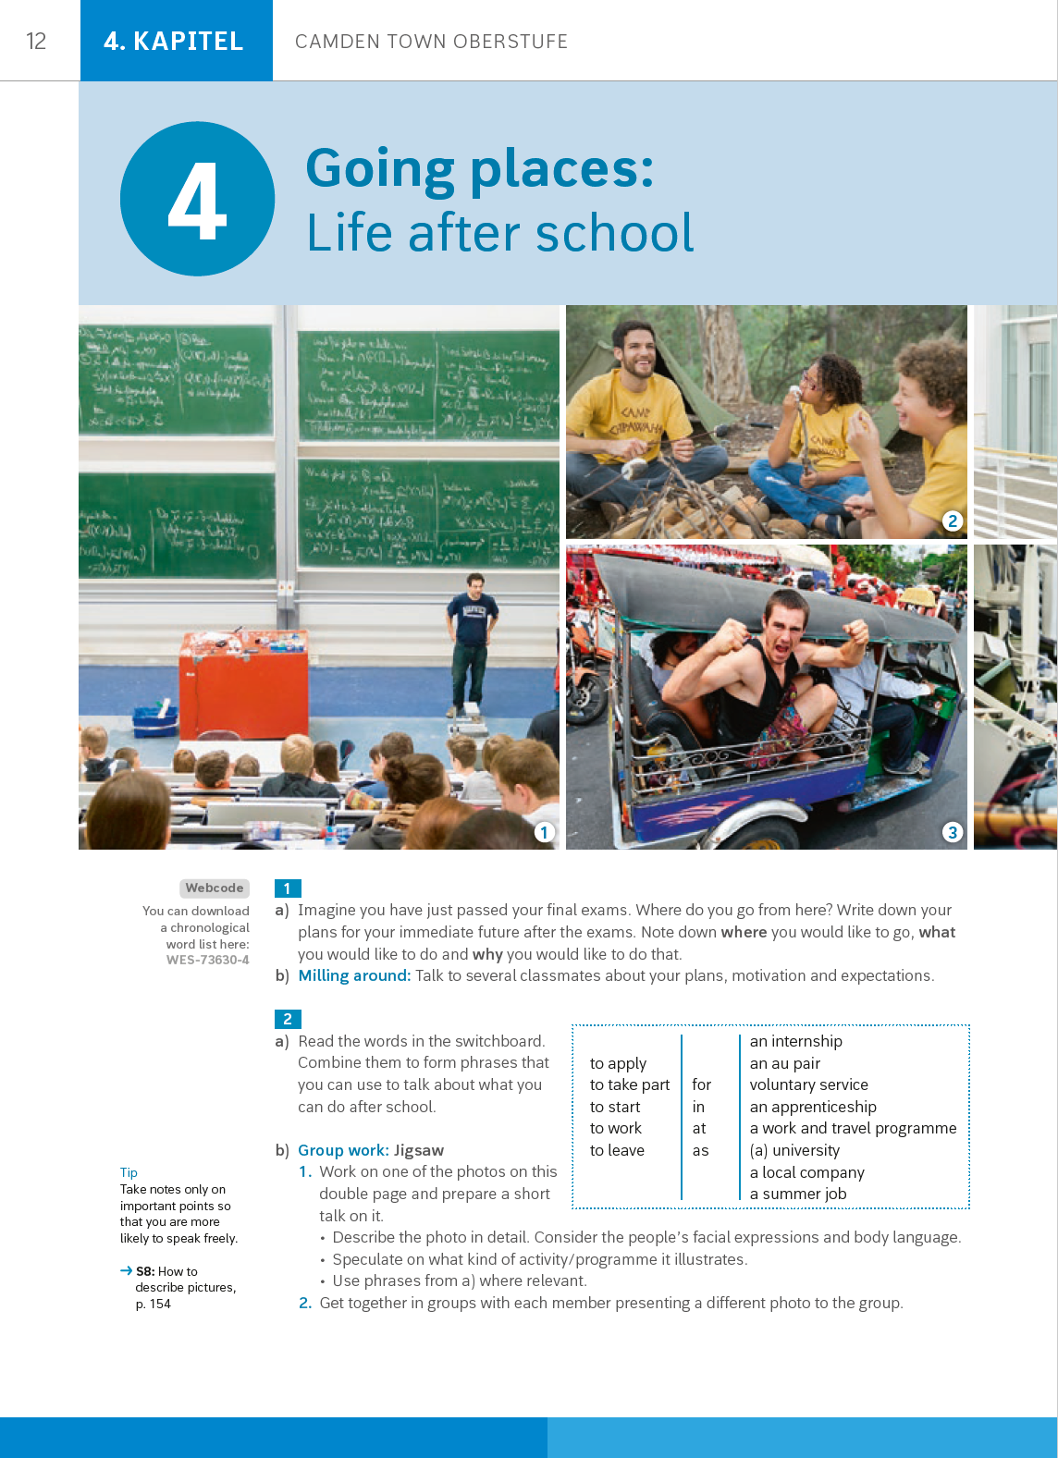
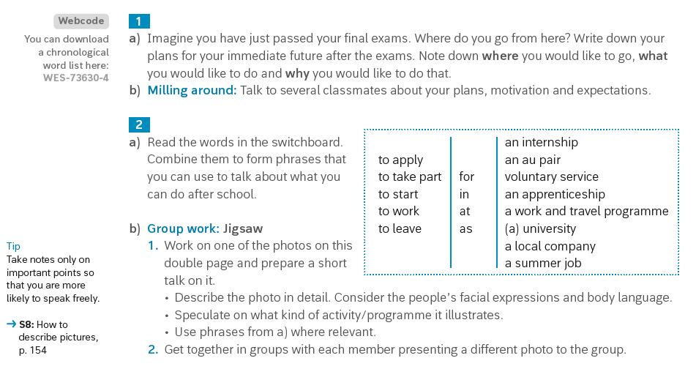

Slide 49
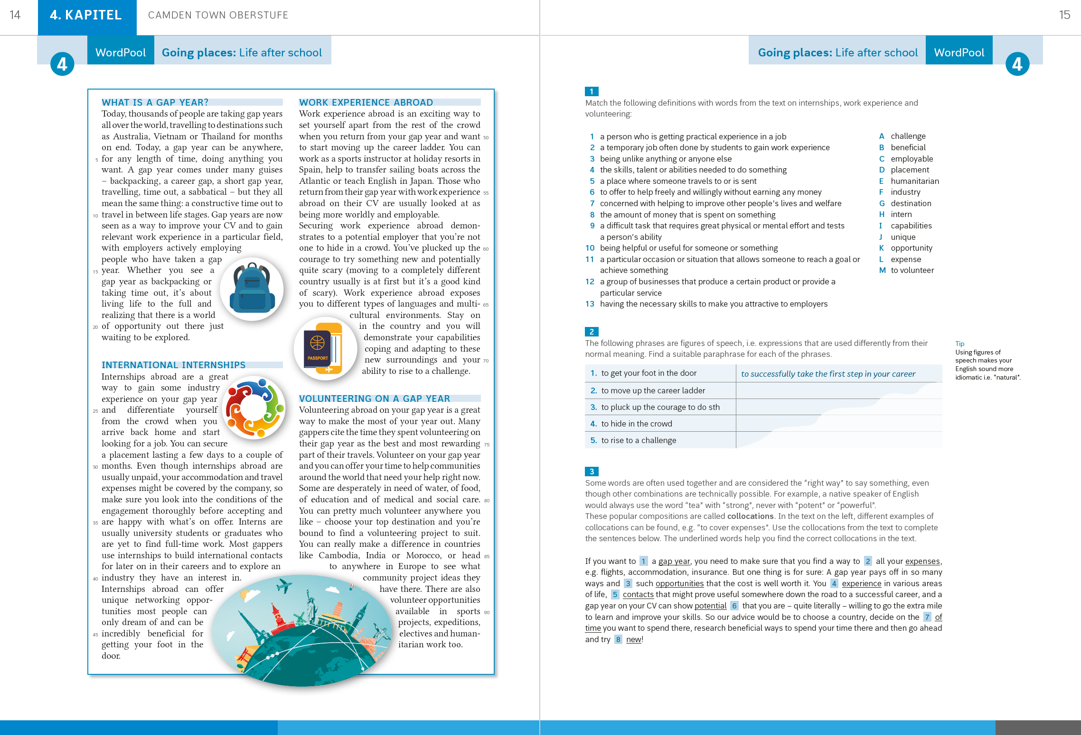

Slide 50
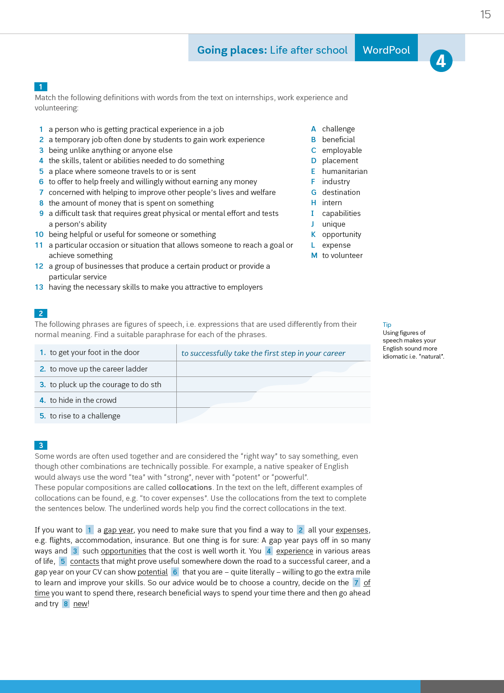
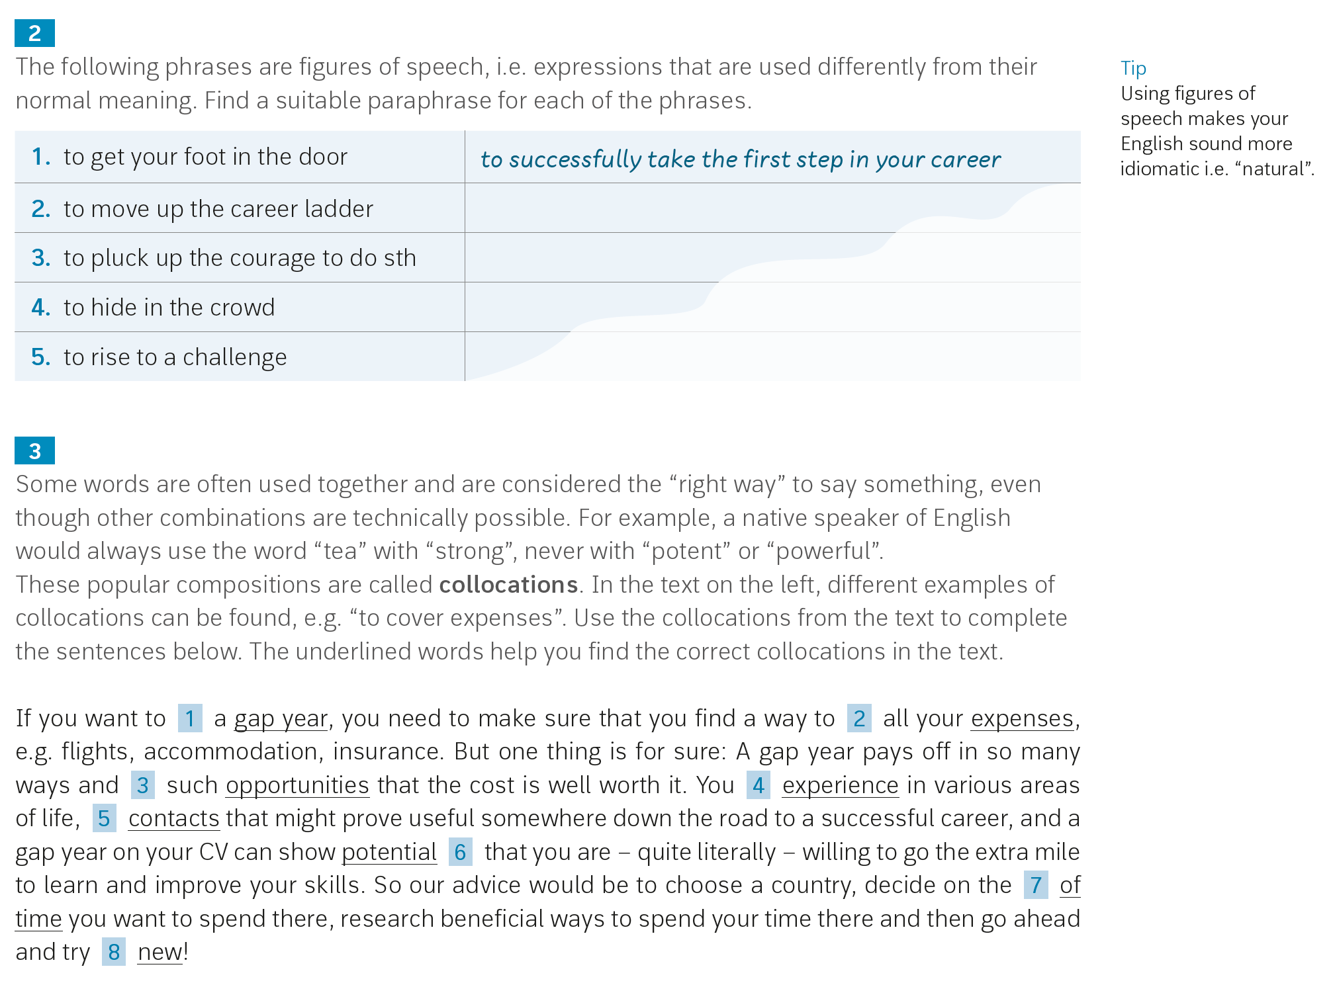

Slide 51
Step by Step
Practice

Slide 52
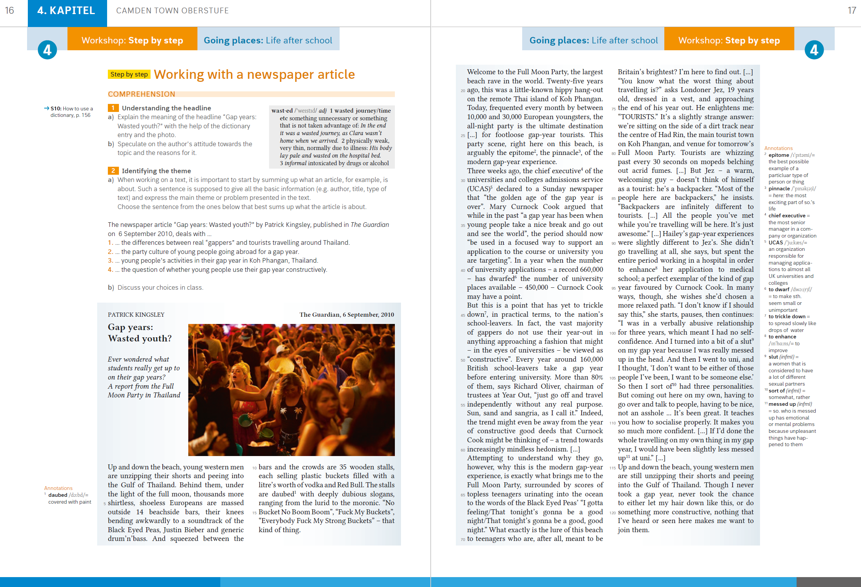

Slide 53
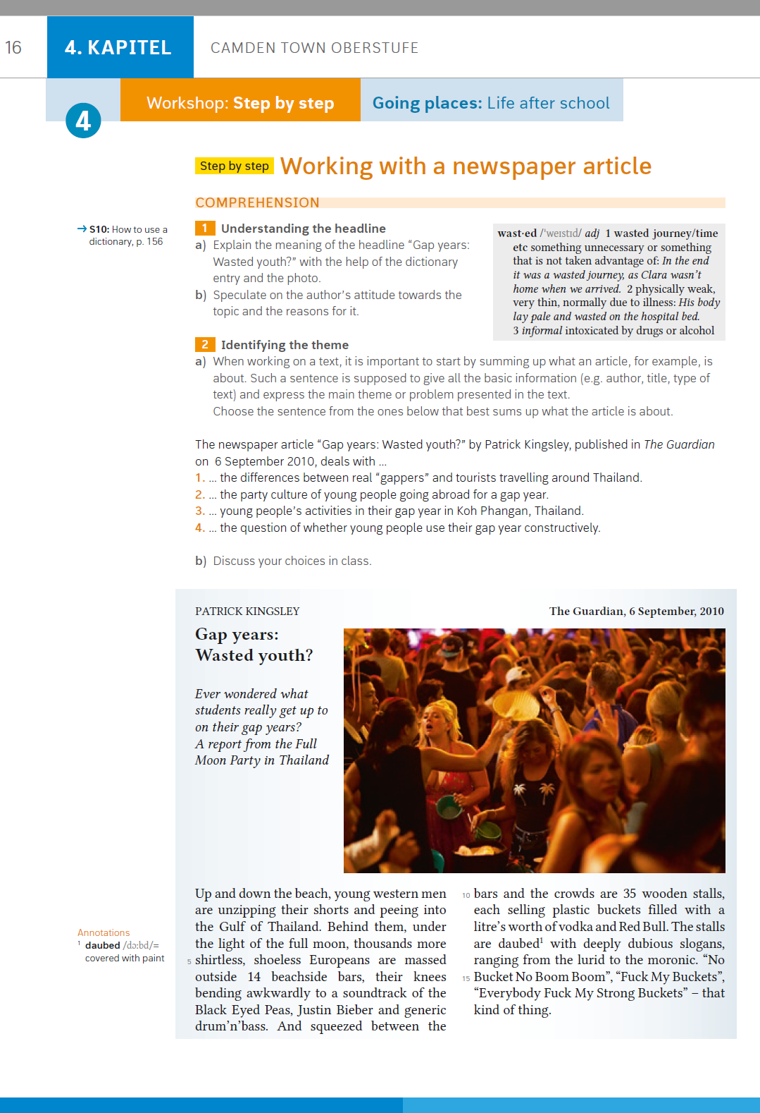
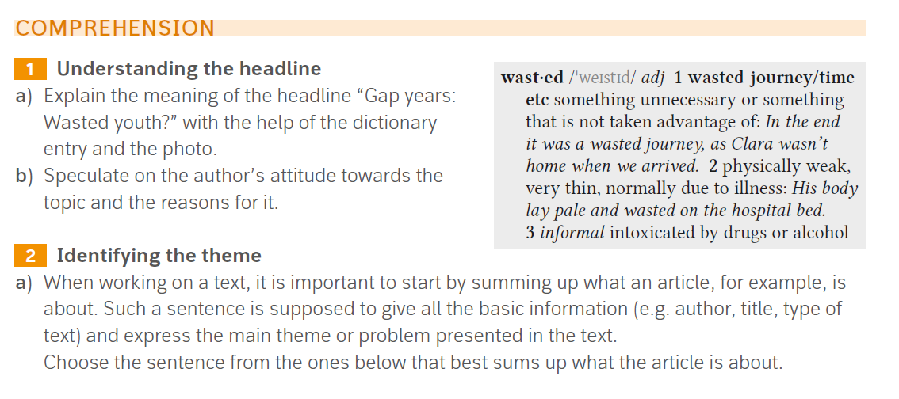

Slide 54
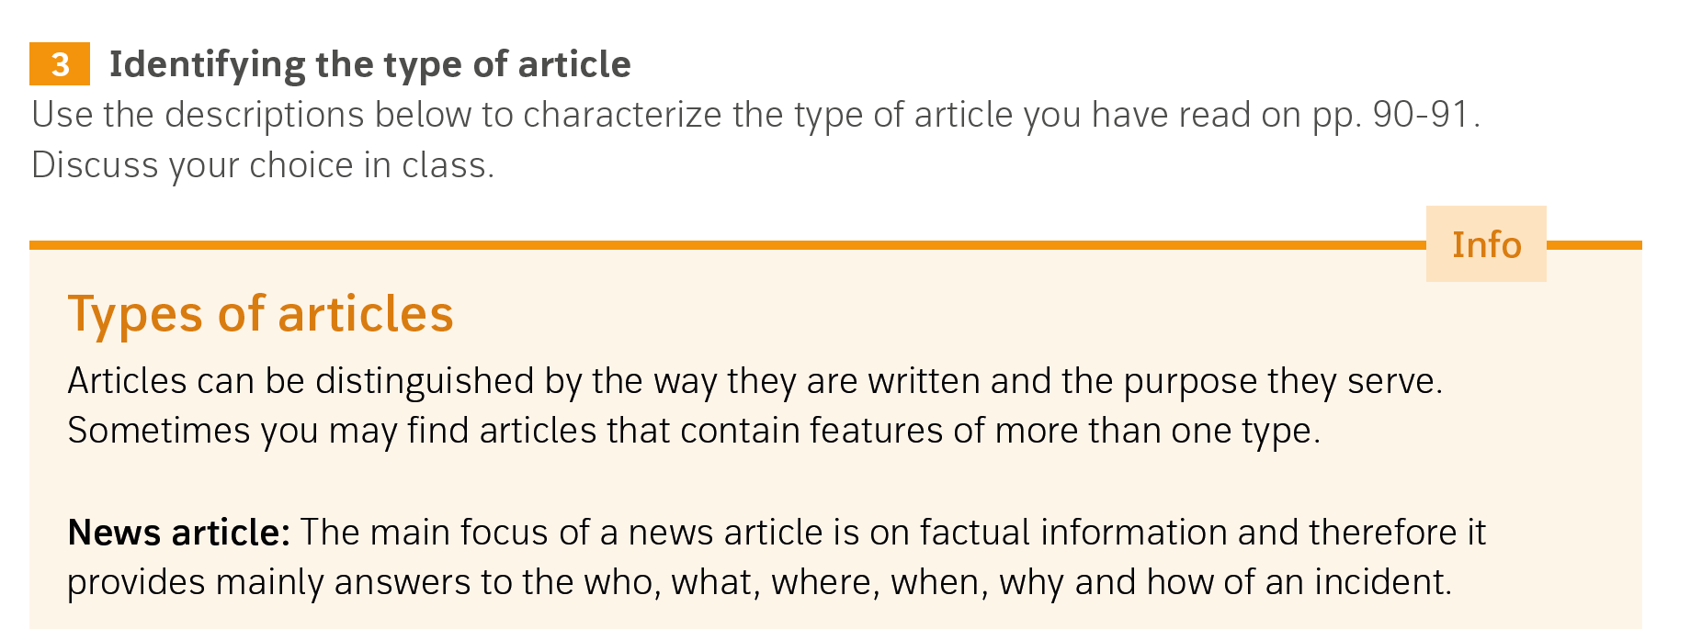
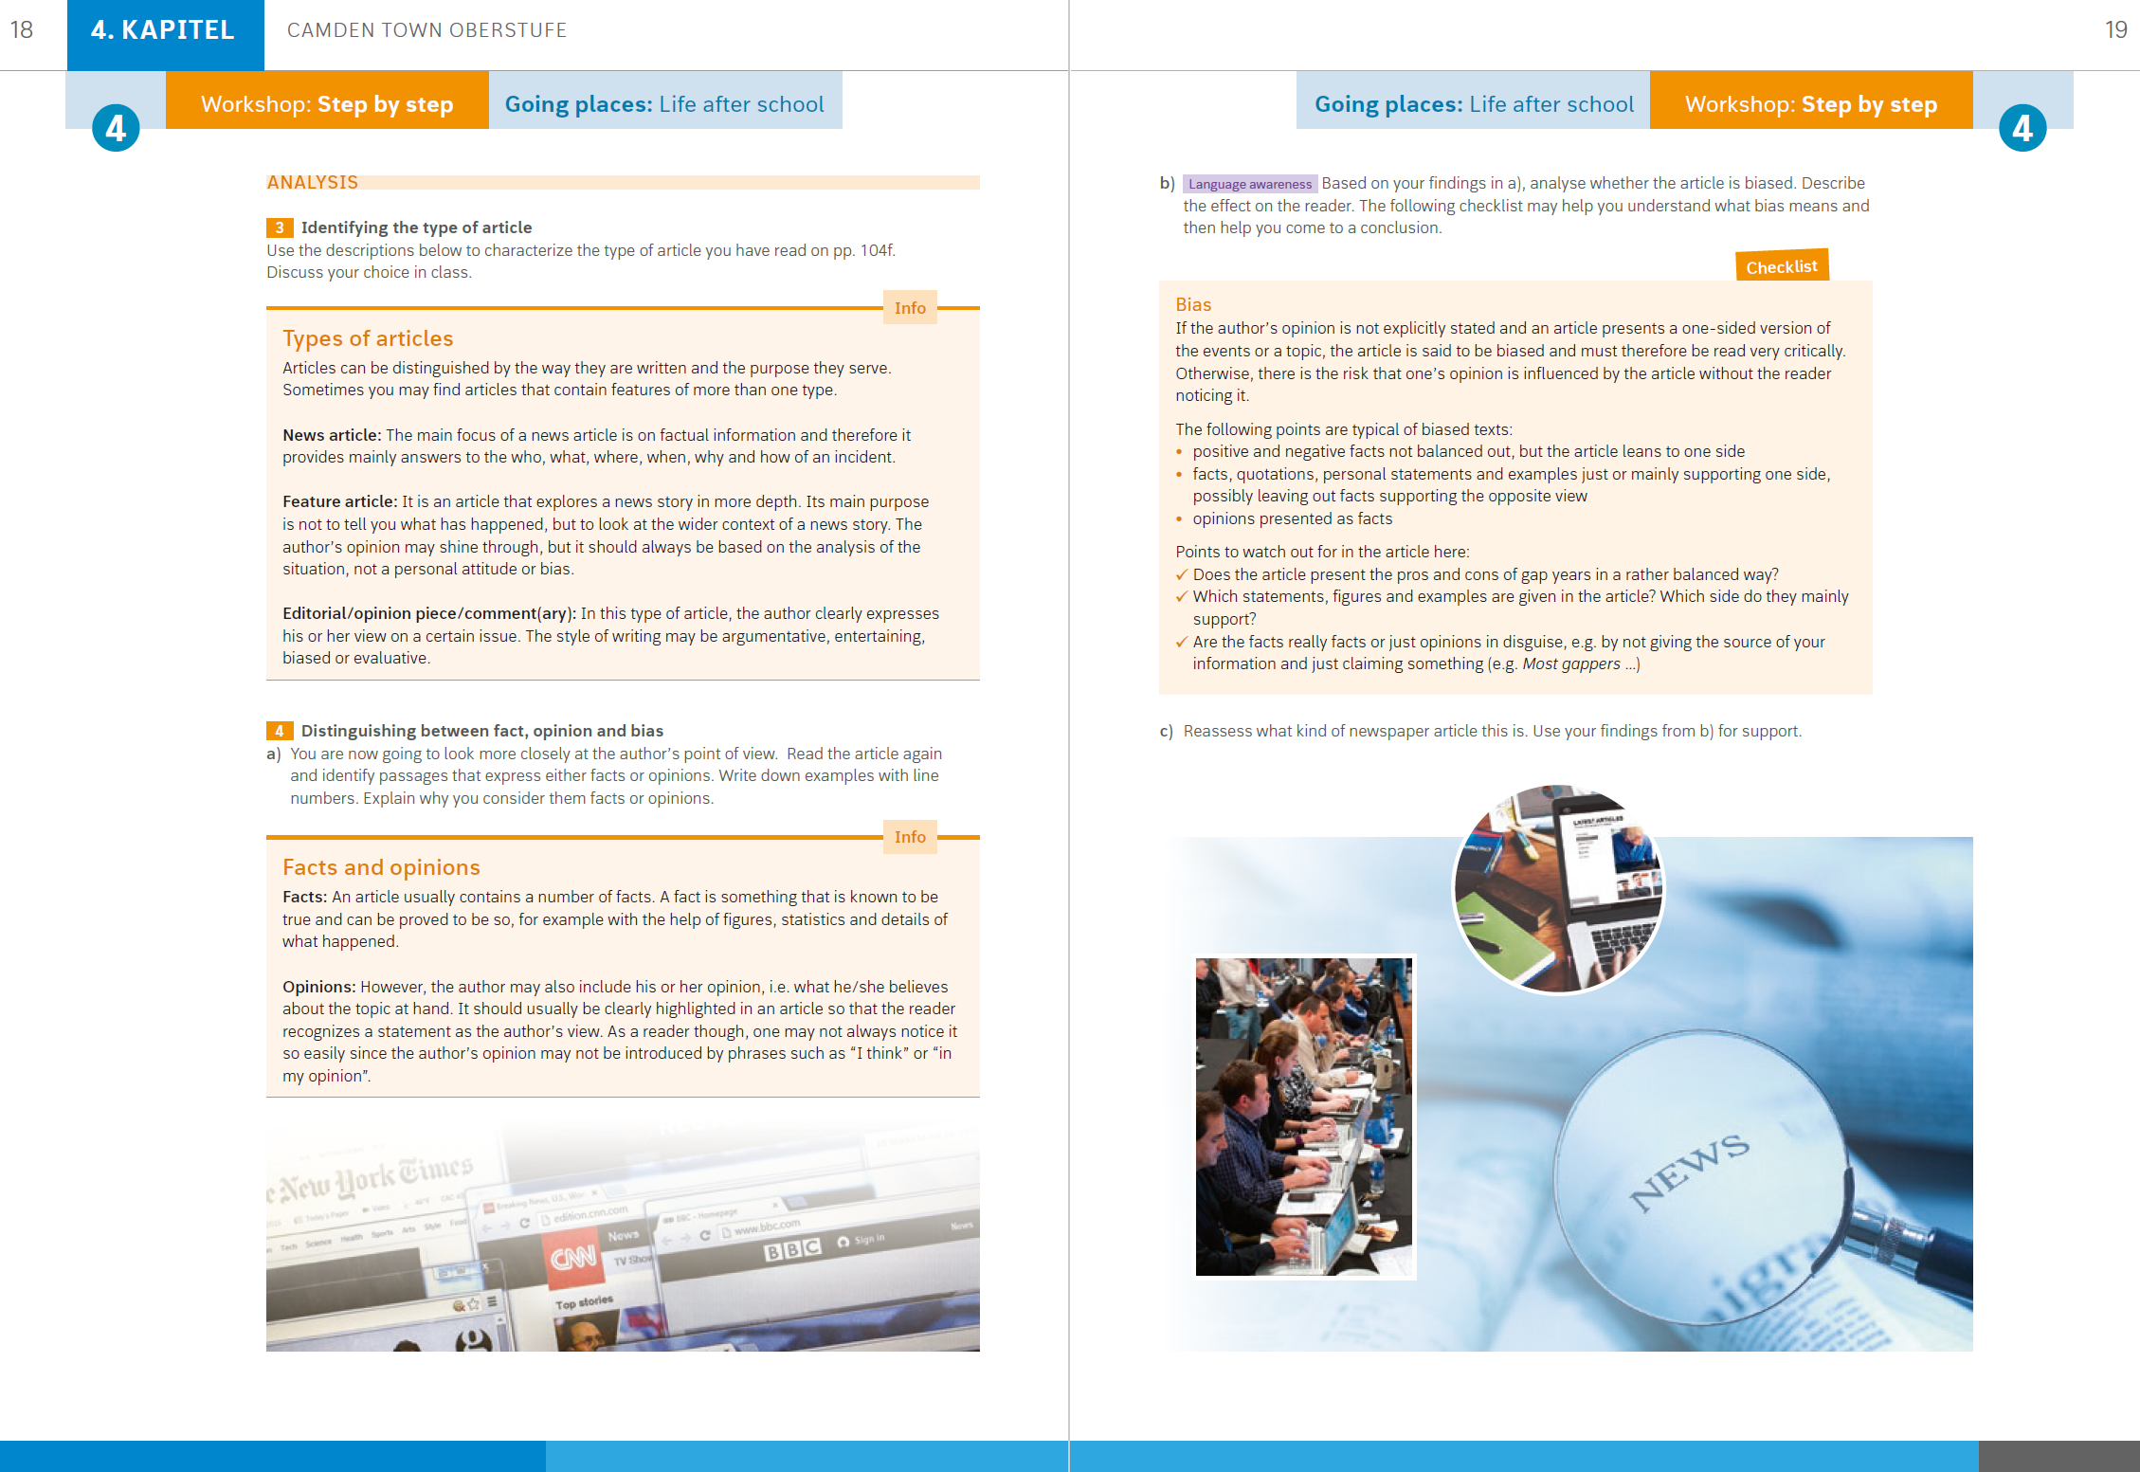

Slide 55
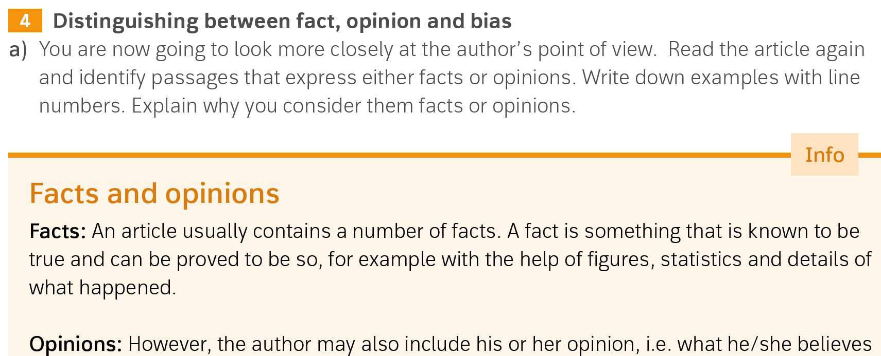

Slide 56
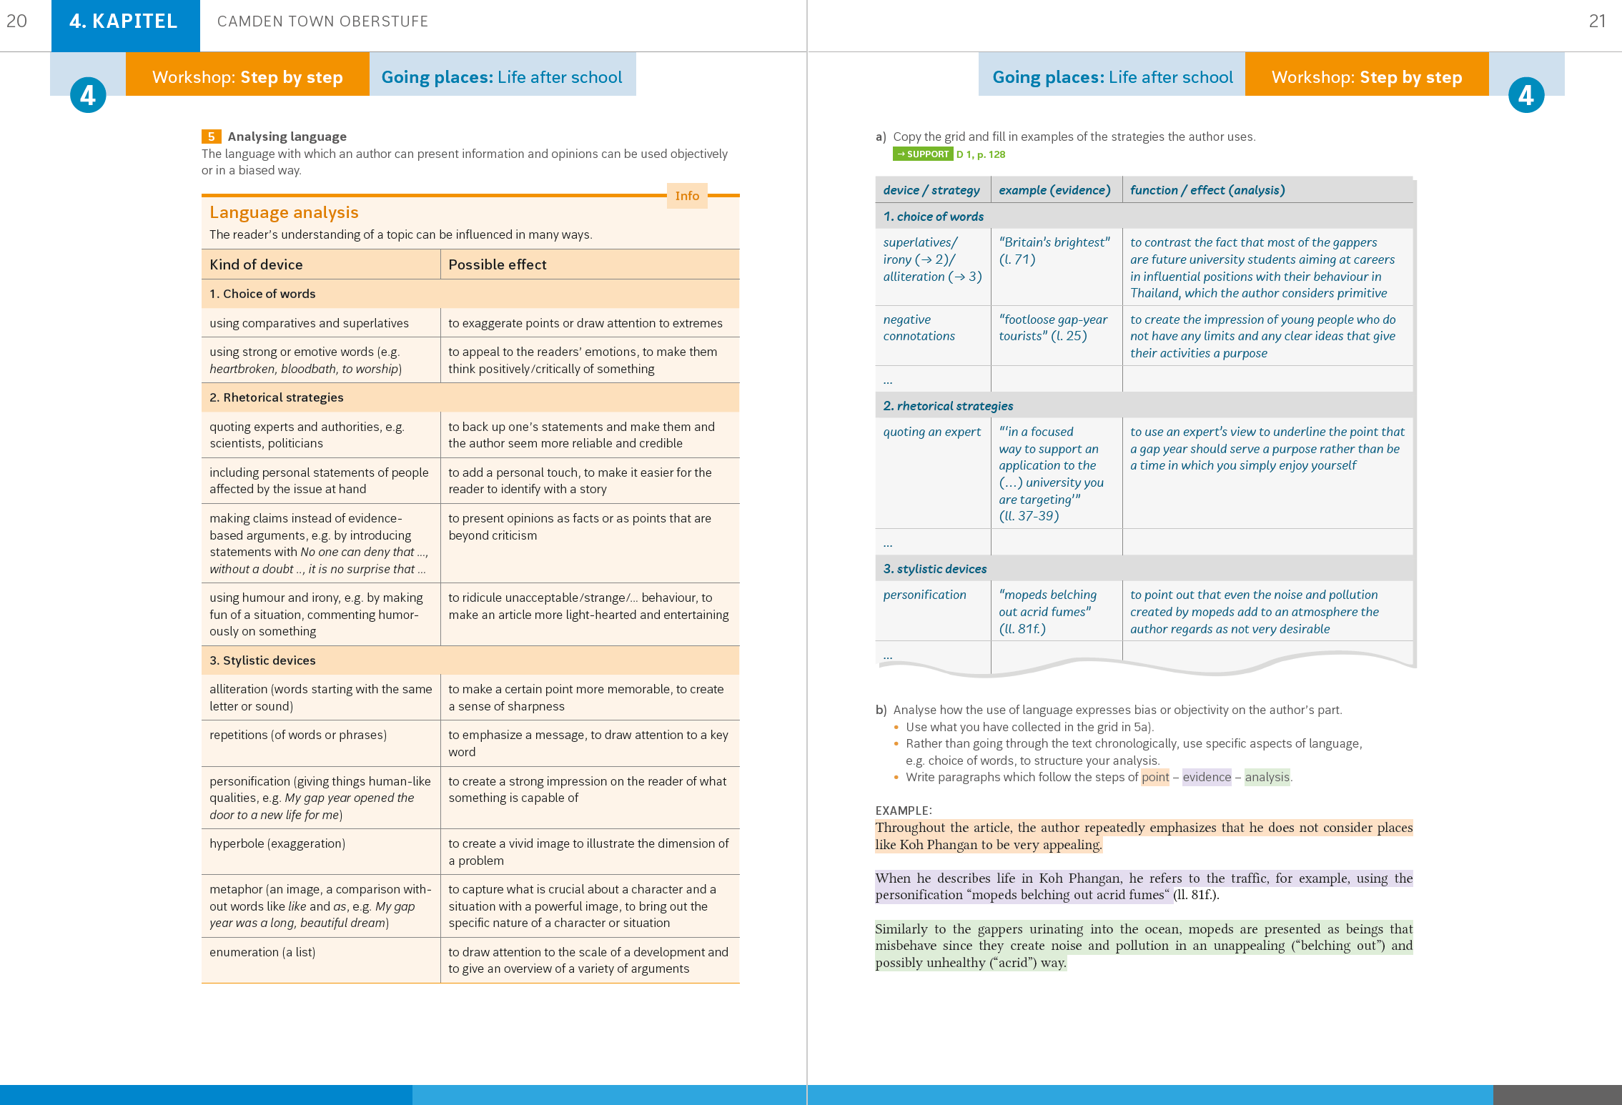

Slide 57
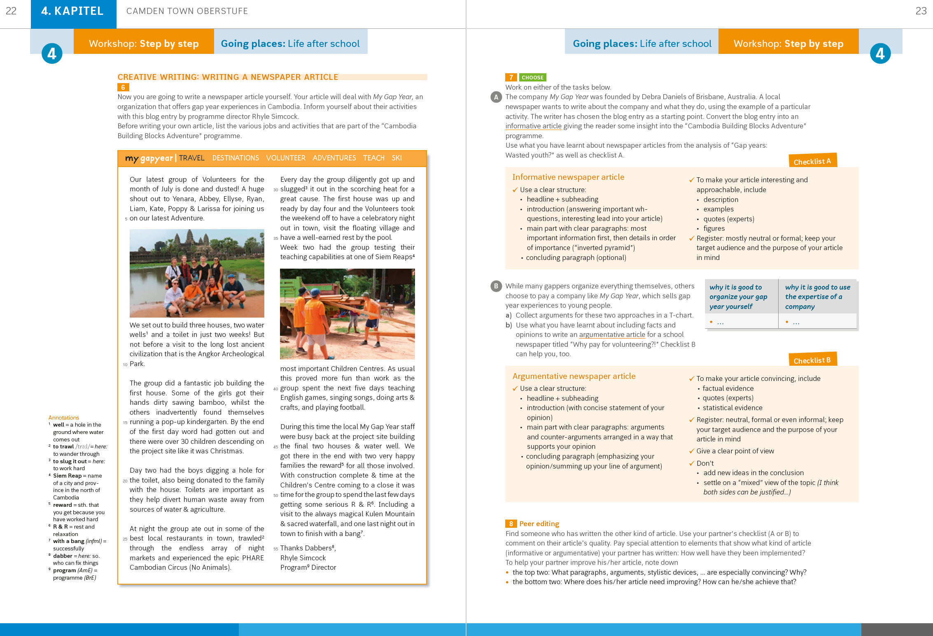

Slide 58
Step by Step
Practice

Slide 59
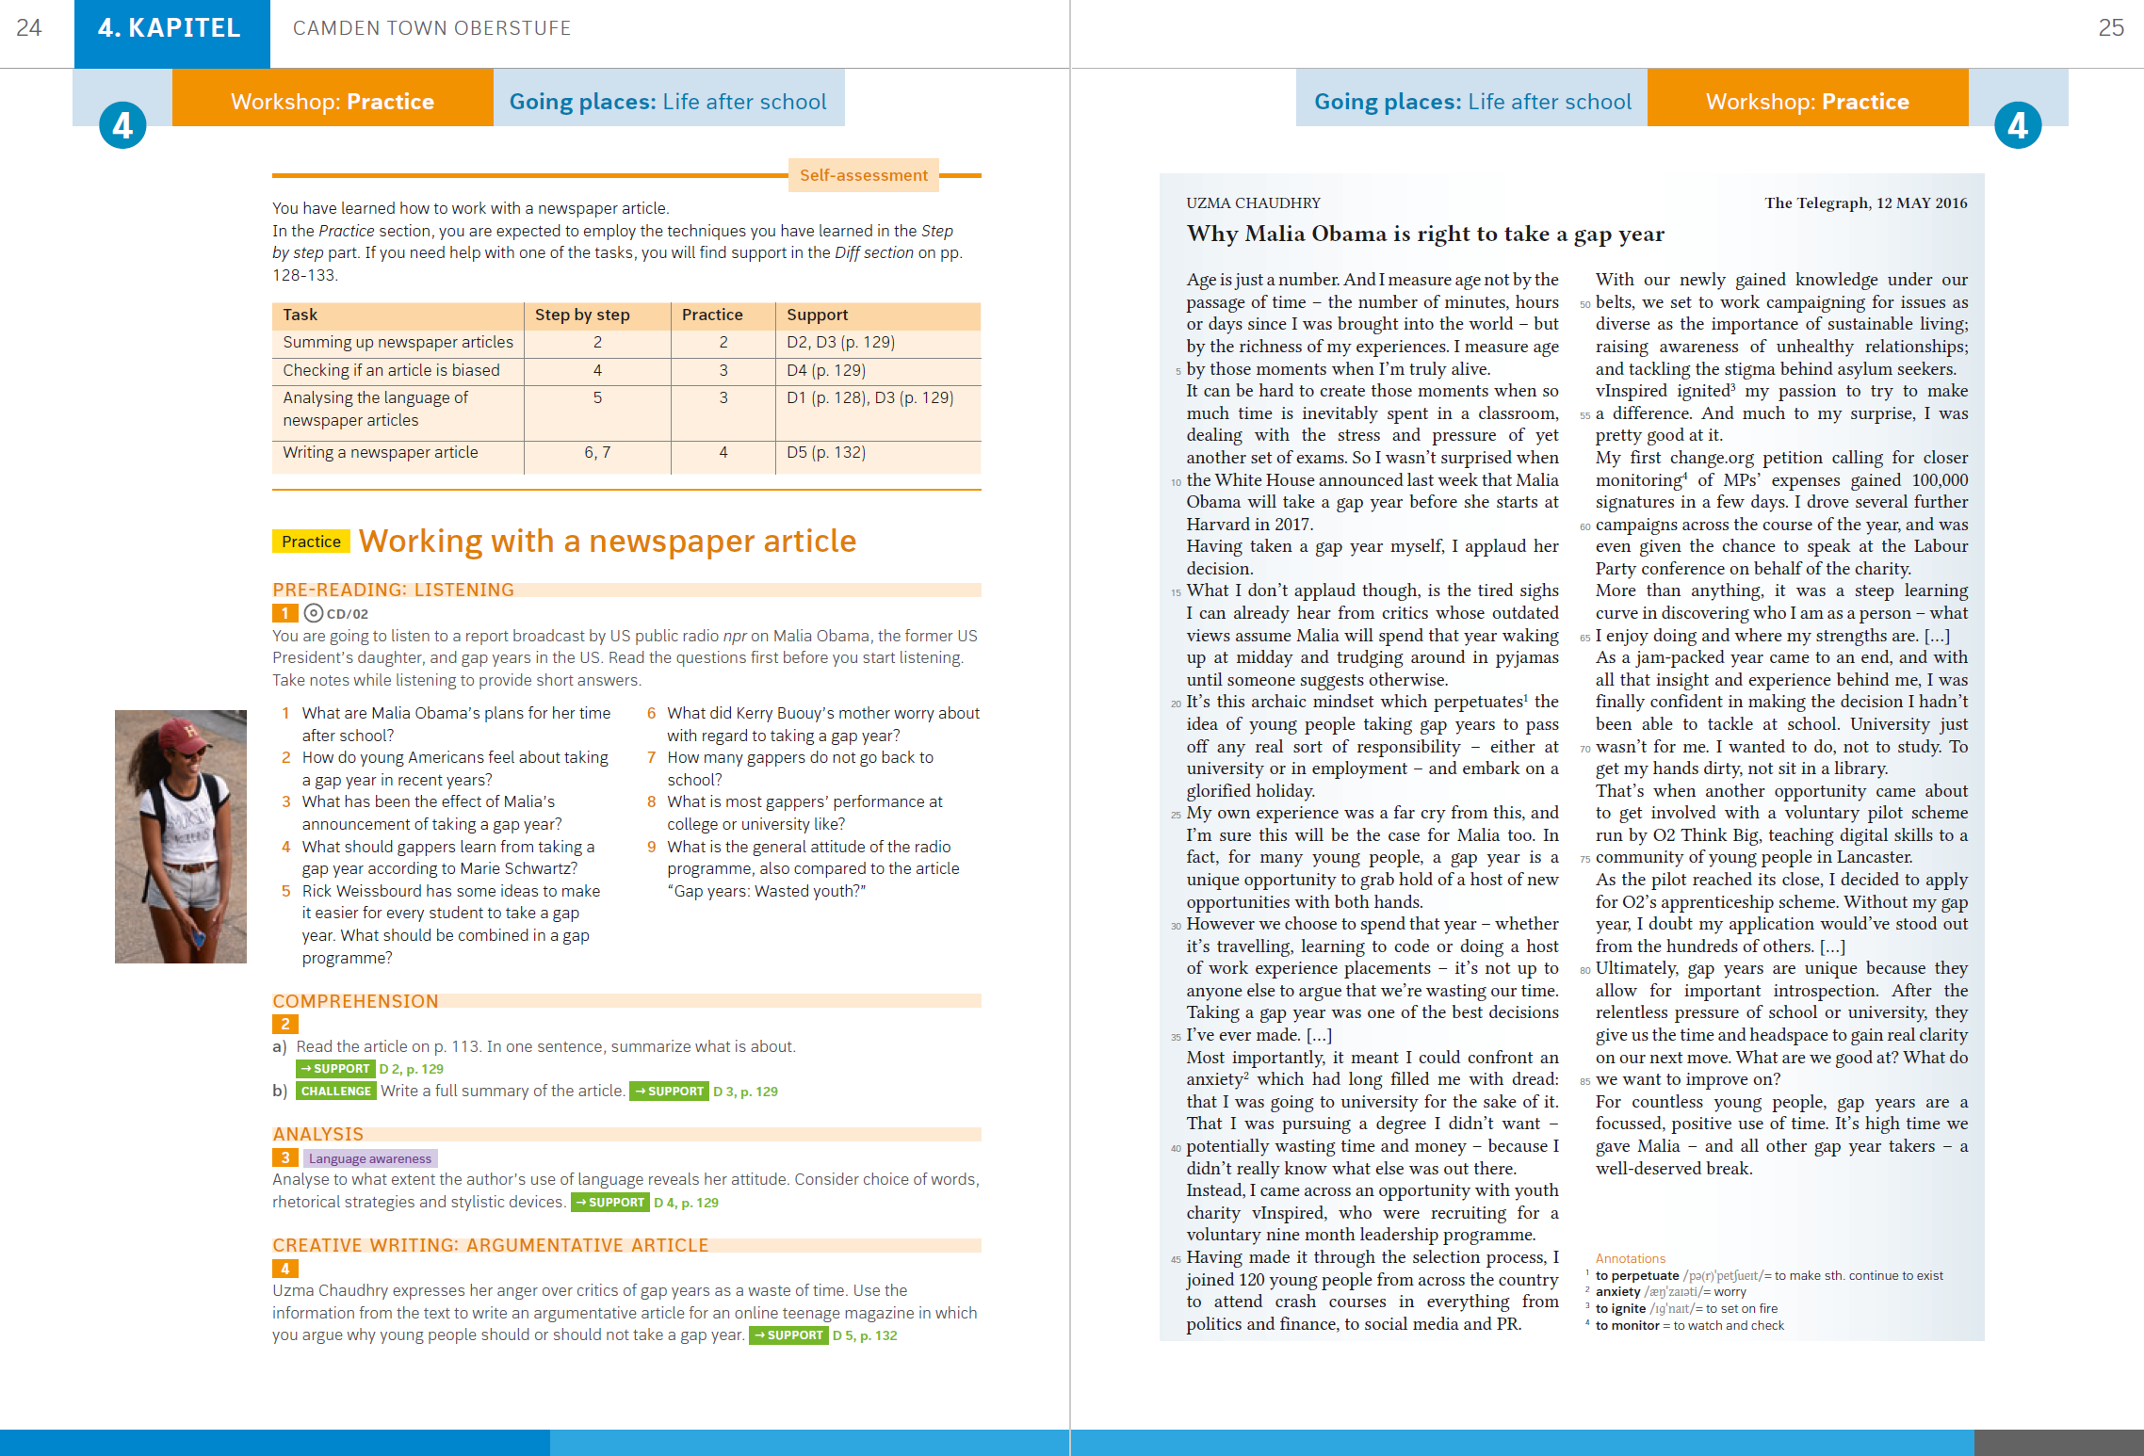

Slide 60
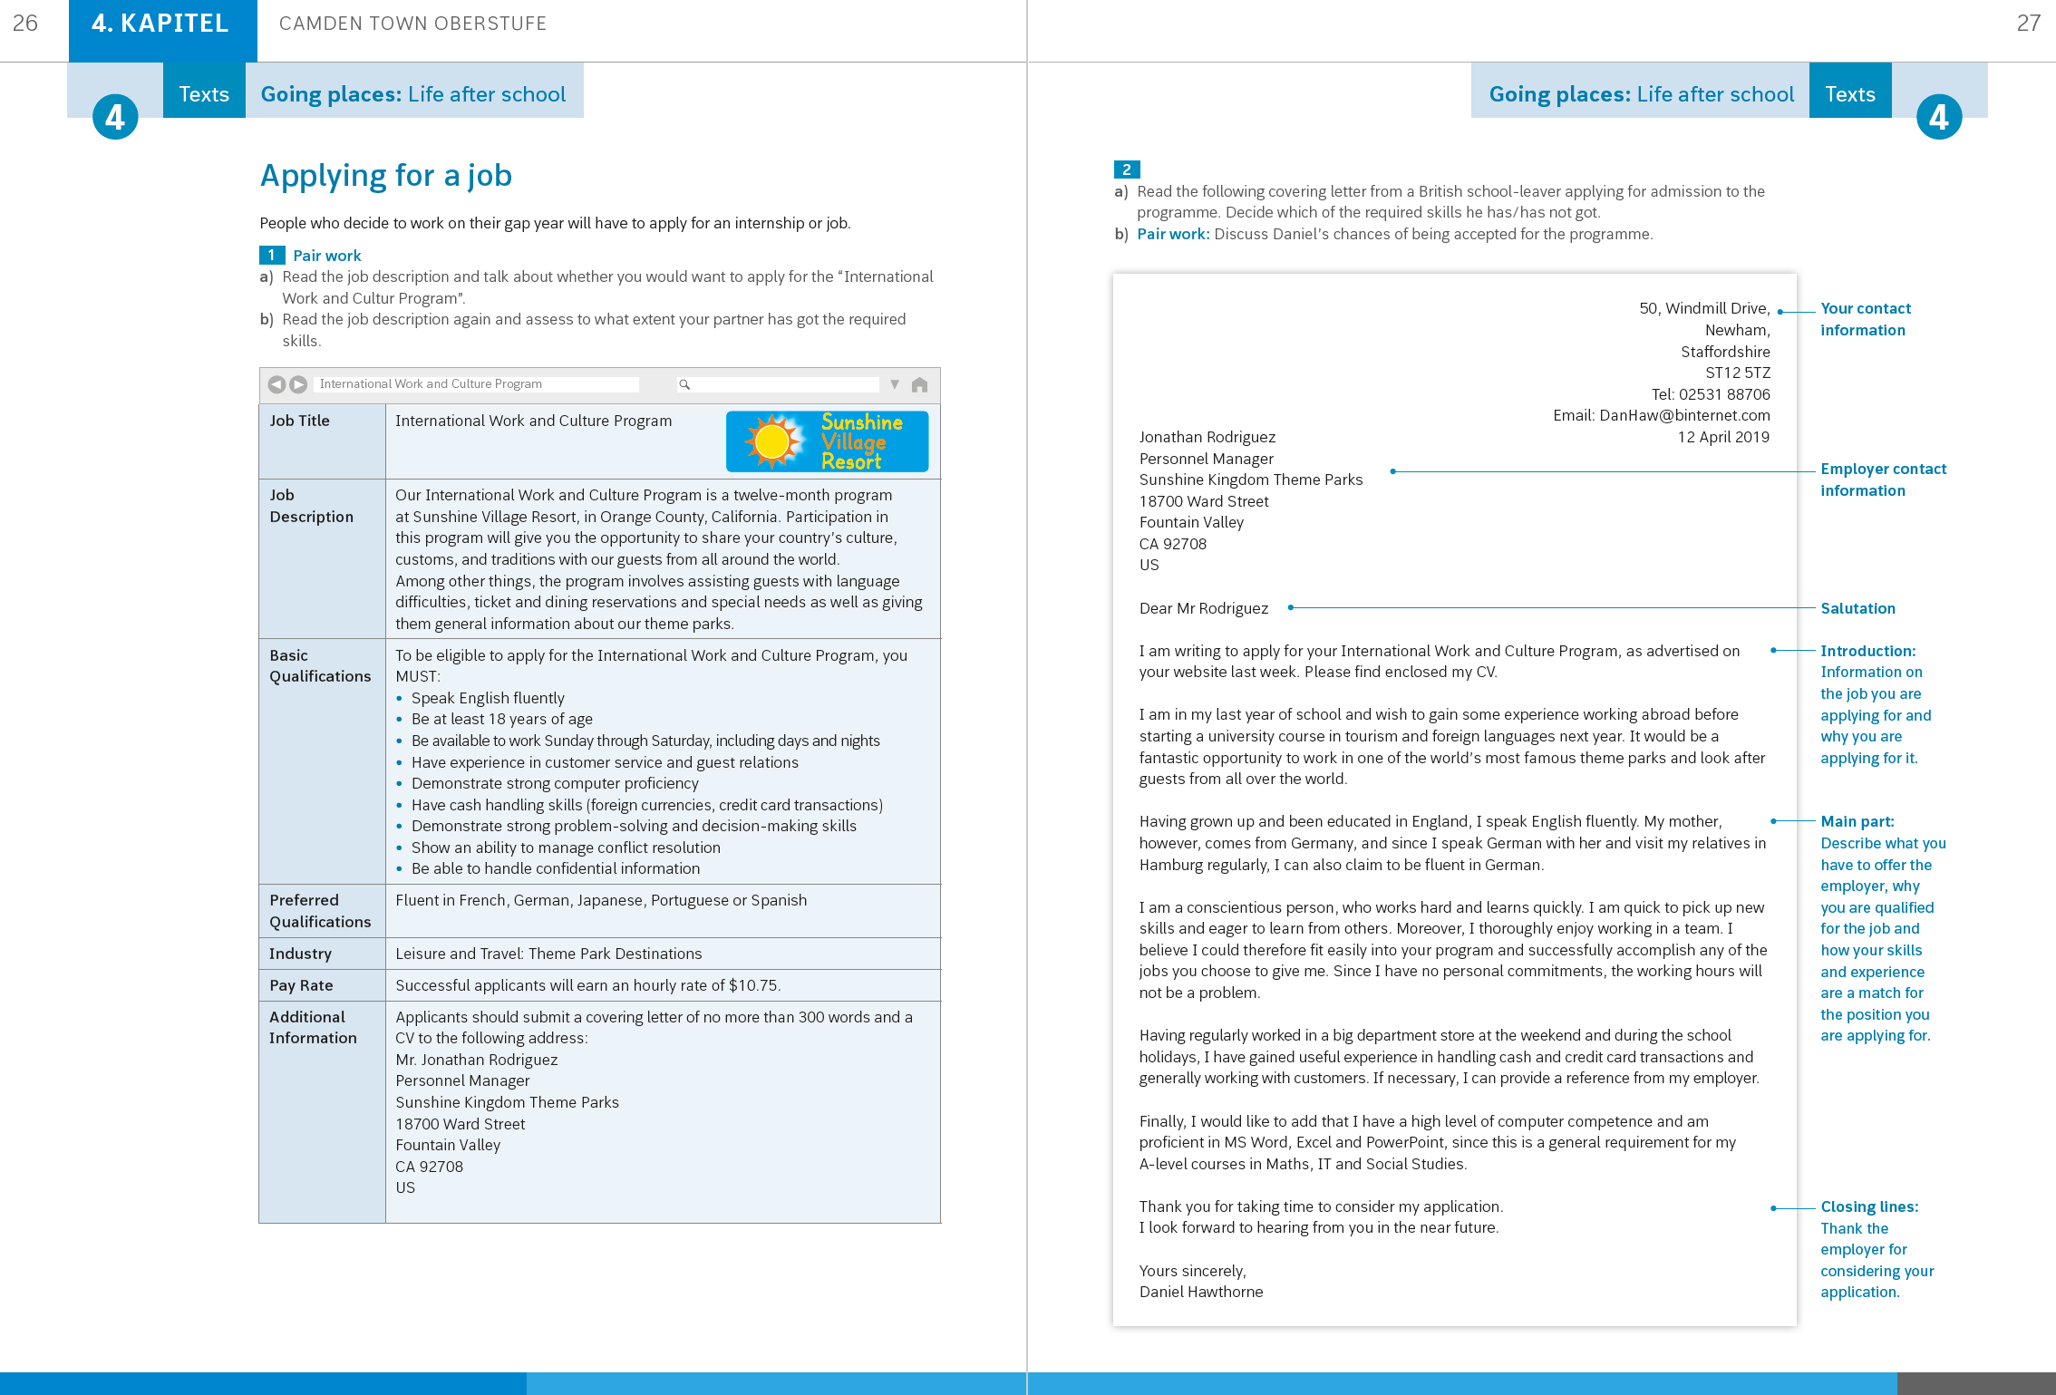

Slide 61
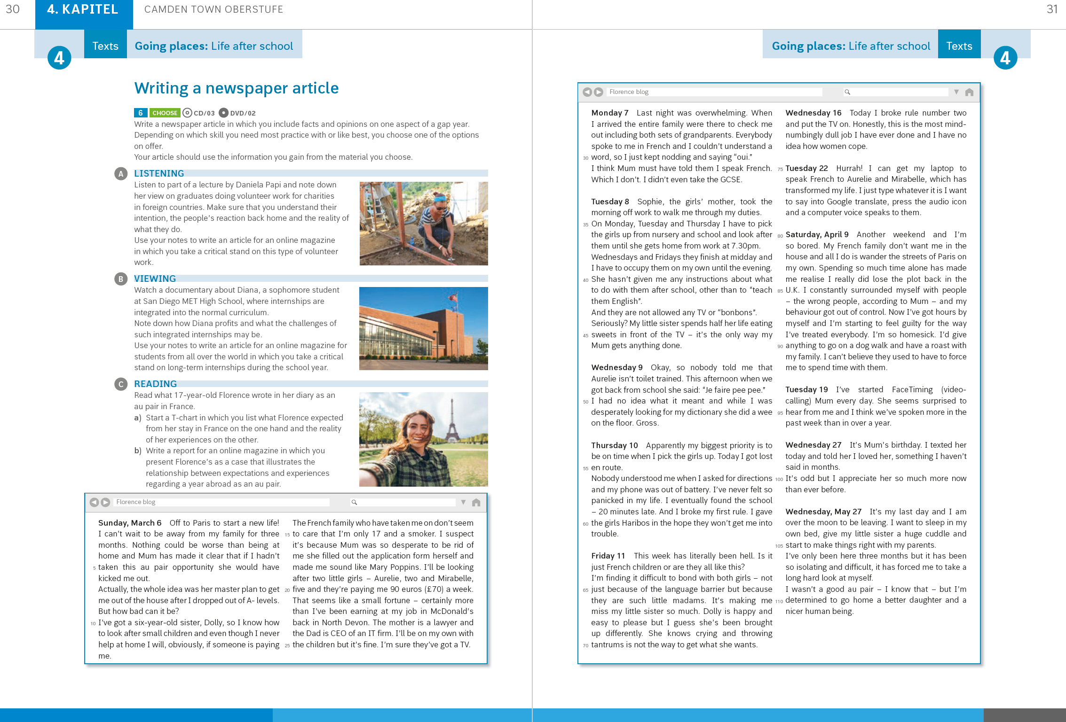

Slide 62
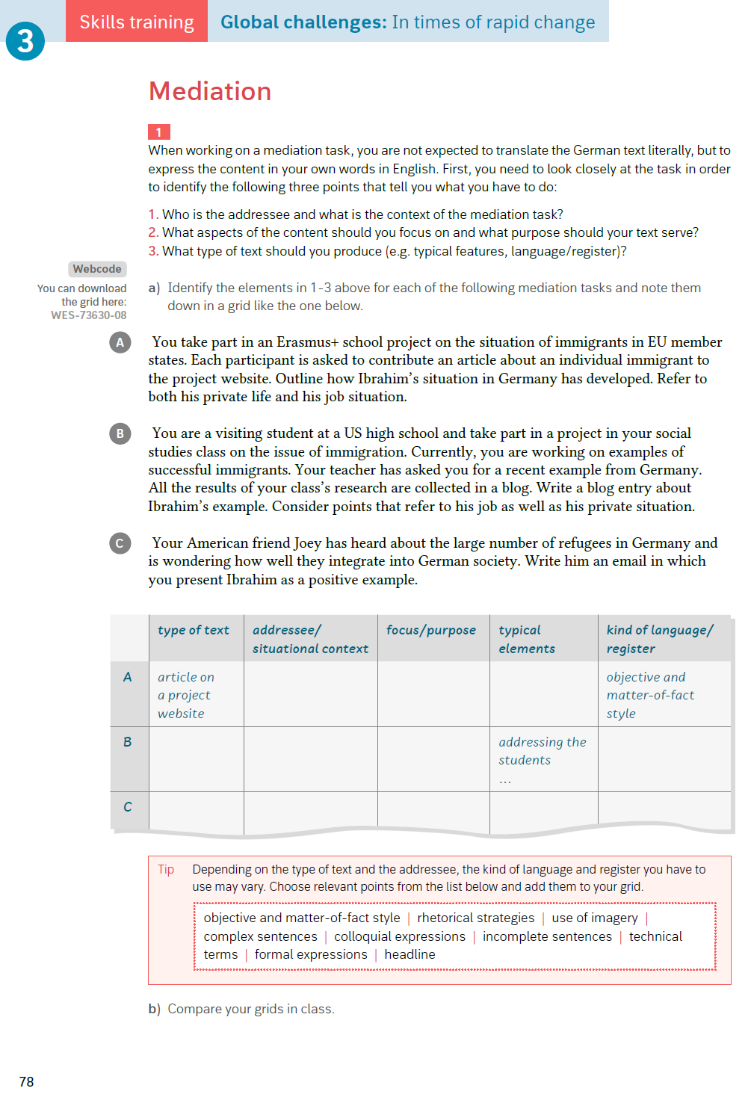
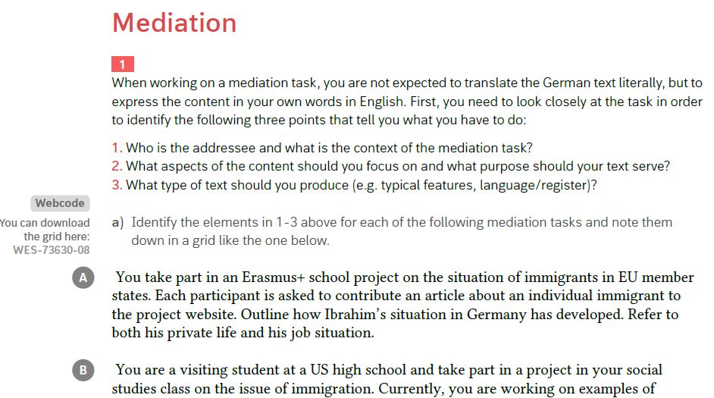

Slide 63
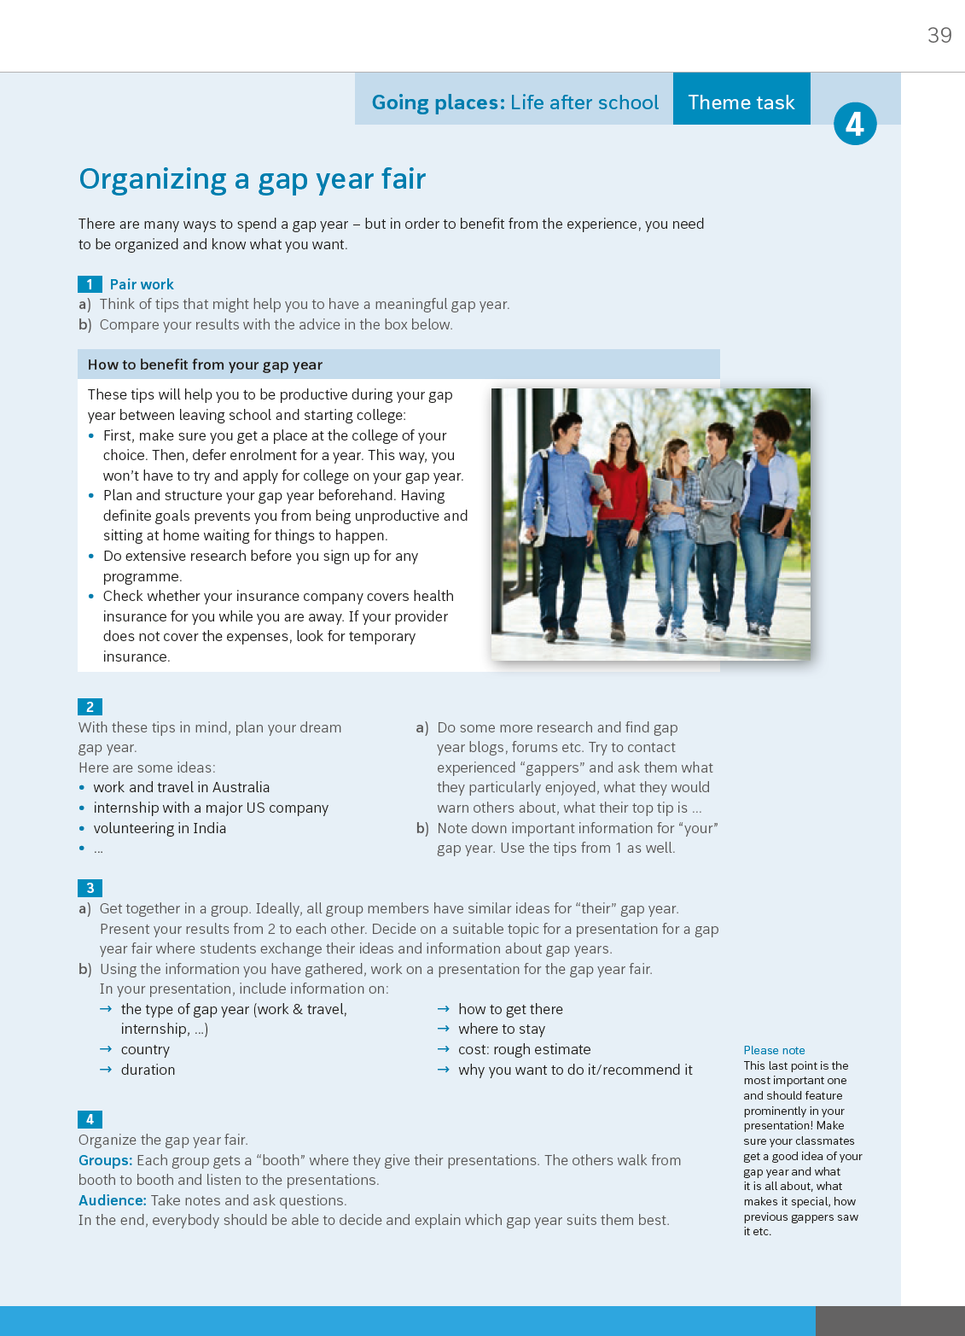

Slide 64
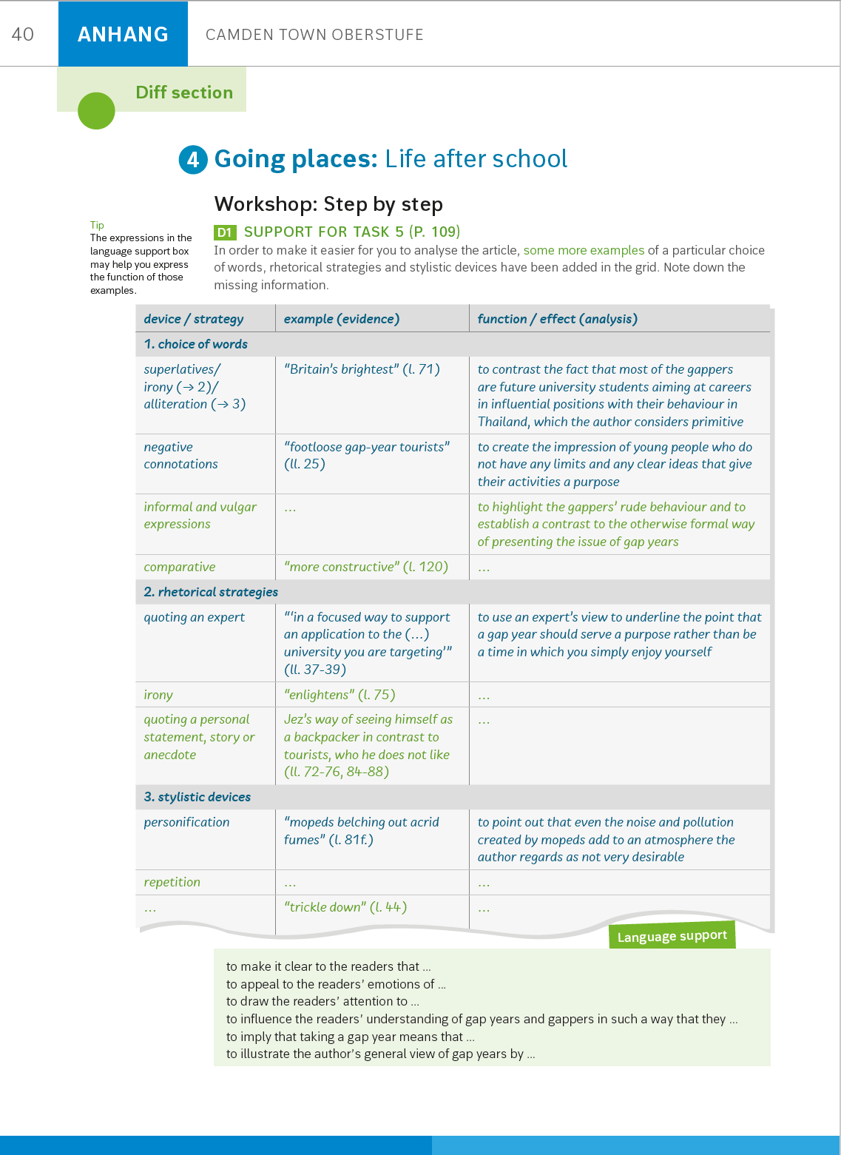
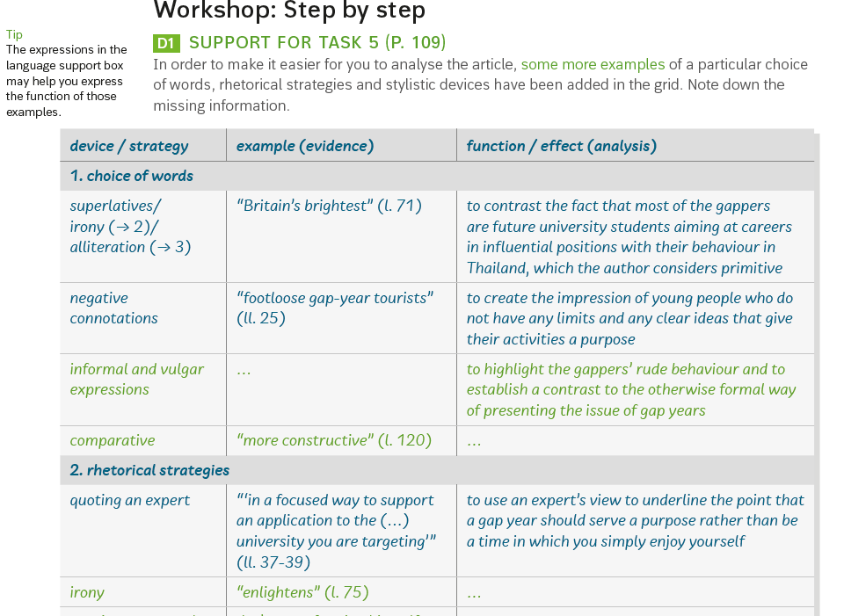

Slide 65
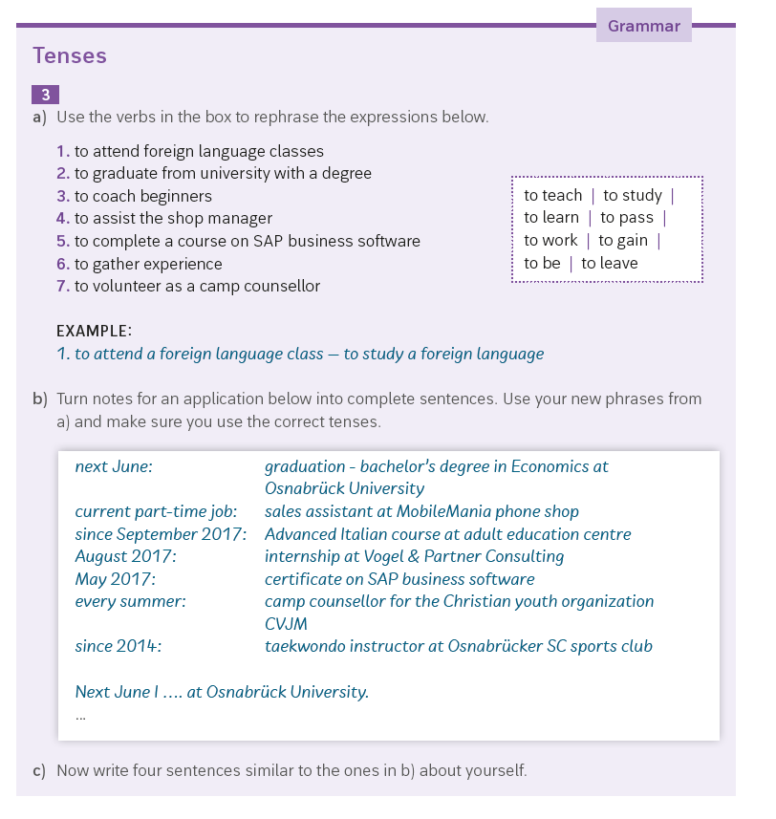

Slide 66
Intro
Wordpool
Workshop
Texts
Skill Training
Theme Task

Slide 67


Slide 68
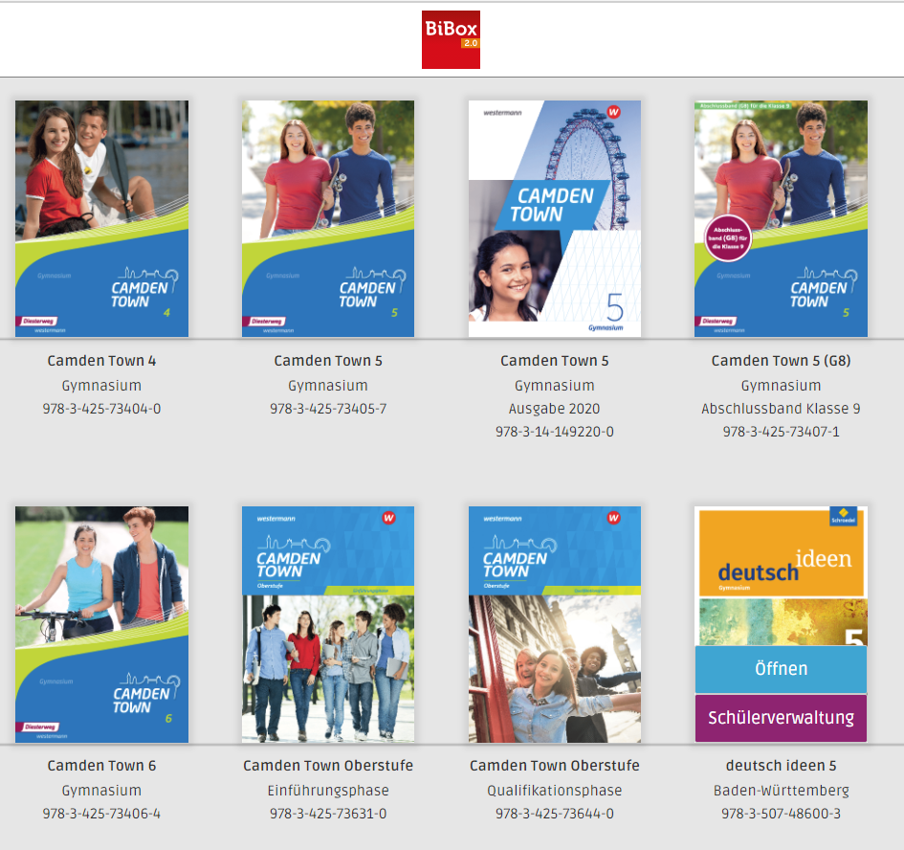

Slide 69








Slide 70

Künstliche Intelligenz
TikTok und Schule
Lehrerfortbildungen
Medienerziehung
podcasts.schule

Slide 71
Kontaktinformationen
Florian Nuxoll
  Twitter:@Herr_Nuxoll
  Medienwelten: http://medienwelten.schule/
  florian.nuxoll@gmx.net

Slide 72
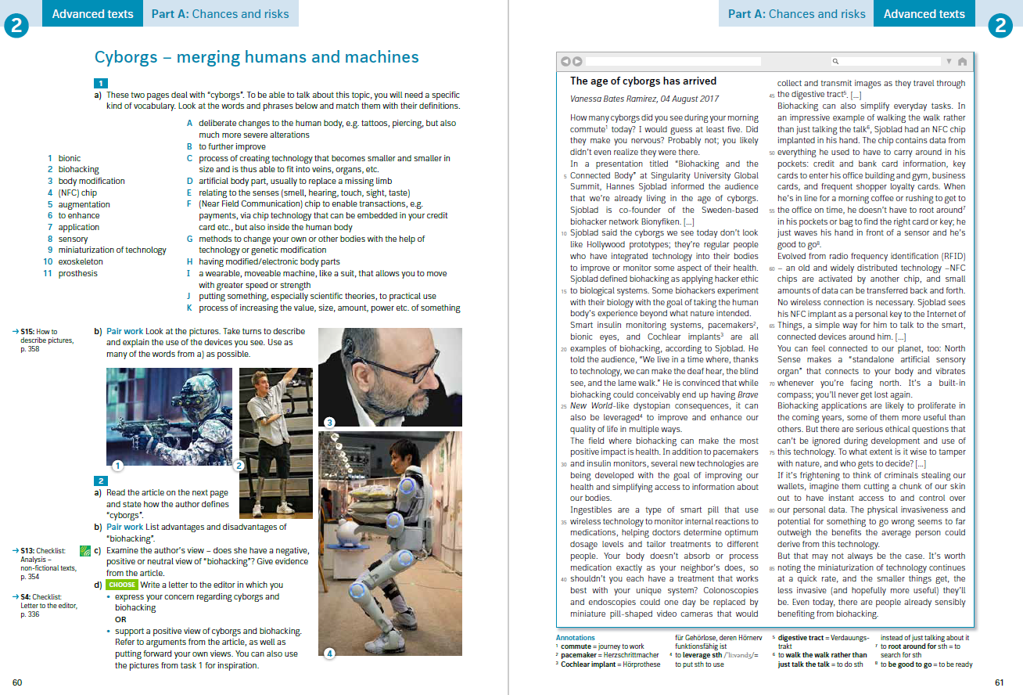

Slide 73
You are a teacher and you want to show your students how to write a letter to the editor. You want to give them several sample letters. Good ones and bad ones. Write 5 different letters. One should score 100%, one 90%, one 75%, one 60% and one less than 50%.

Slide 74
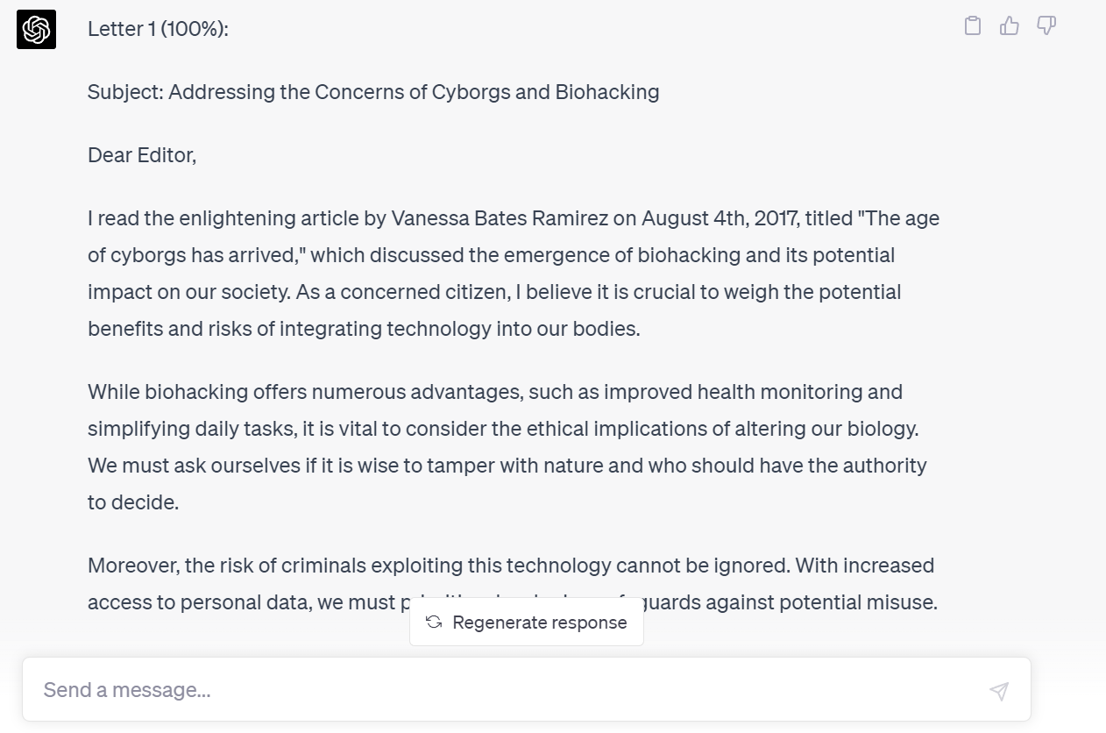

Slide 75
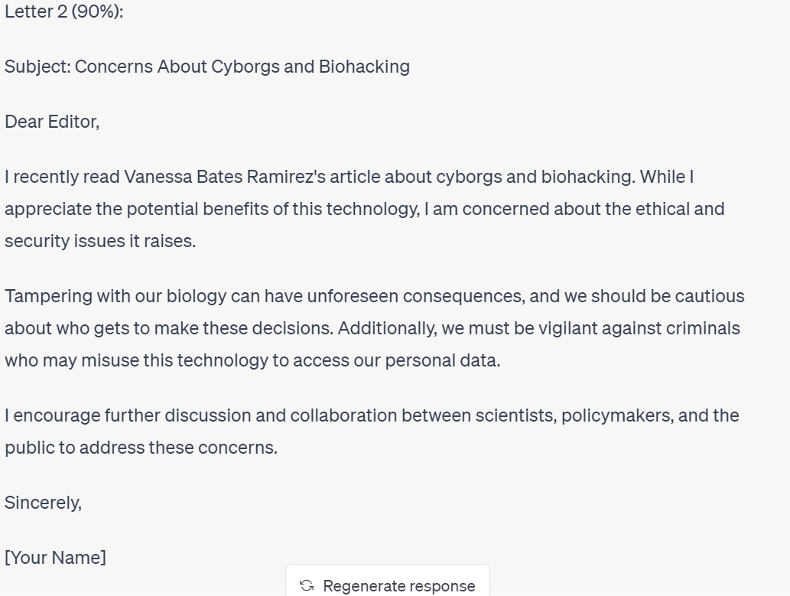

Slide 76
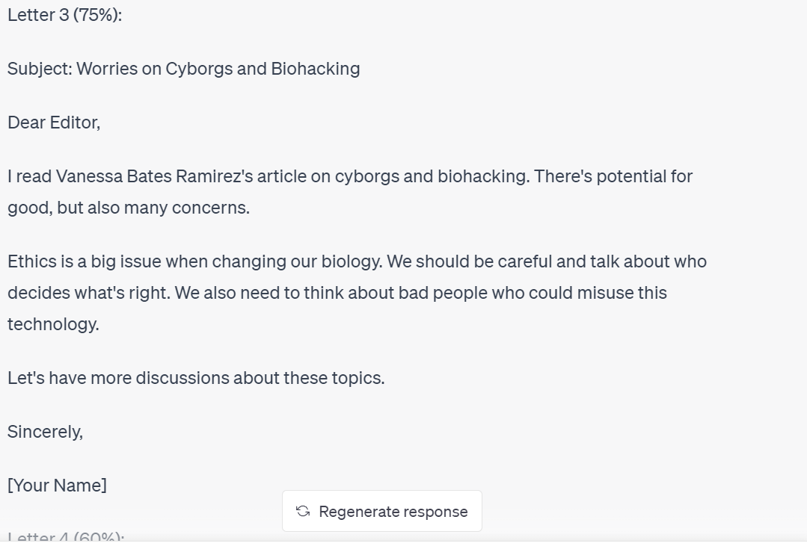

Slide 77
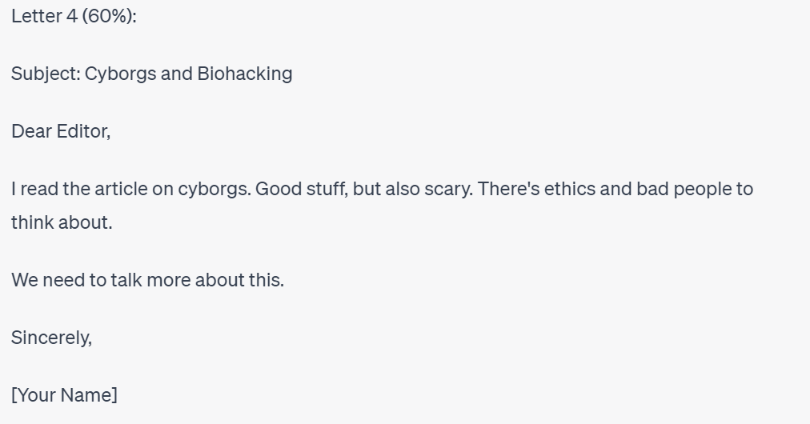

Slide 78


Slide 79
Kontaktinformationen
Florian Nuxoll
  Twitter:@Herr_Nuxoll
  Medienwelten: http://medienwelten.schule/
  florian.nuxoll@gmx.net
  Podcast: https://doppelstunde.letscast.fm/

